Slide 1

“Do Not Pass Go” – Common Issues With Contractual Time Bar Clauses
CCI
DATE: Tuesday 24th March 2026
TIME: 11:00 – 12:00
LOCATION: Online via Zoom

Slide 2
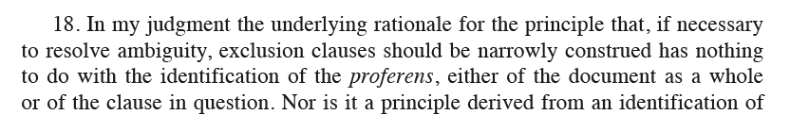
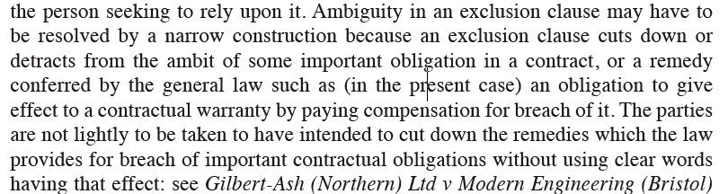
Parameters of the interpretive exercise
The traditional approach: time bar clauses as exclusion clauses and interpreted narrowly. Nobahar-Cookson v Hut Group [2016] EWCA Civ 128:

Slide 3
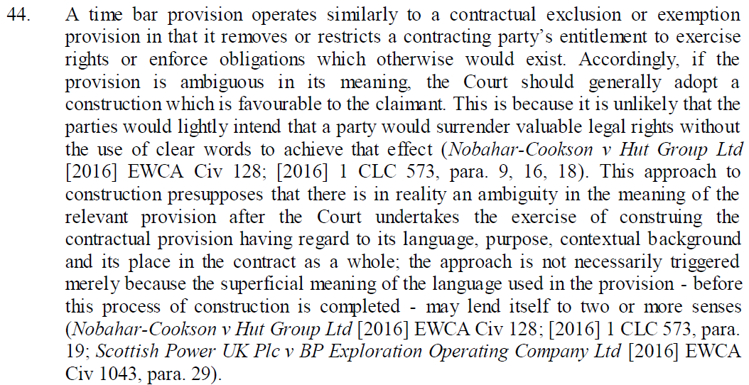
Parameters of the interpretive exercise
Tempered by commercial common sense? Arab Lawyers Network Company Limited v Thomas Reuters (Professional) UK Limited [2021] EWHC 1728 (Comm):

Slide 4
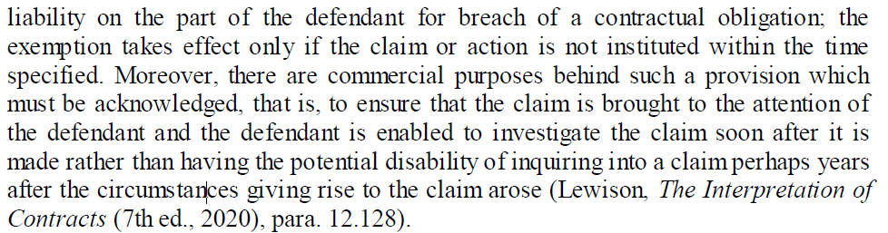
Parameters of the interpretive exercise
Tempered by commercial common sense? Arab Lawyers Network Company Limited v Thomas Reuters (Professional) UK Limited [2021] EWHC 1728 (Comm):

Slide 5
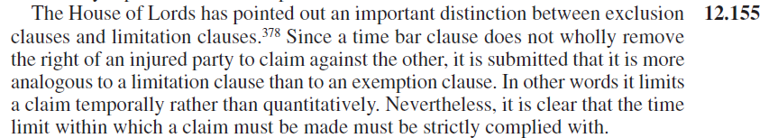
Parameters of the interpretive exercise
Potentially reflective of the less hostile interpretation of limitation clauses v exclusion clauses? See Lewison on Interpretation of Contracts:

Slide 6
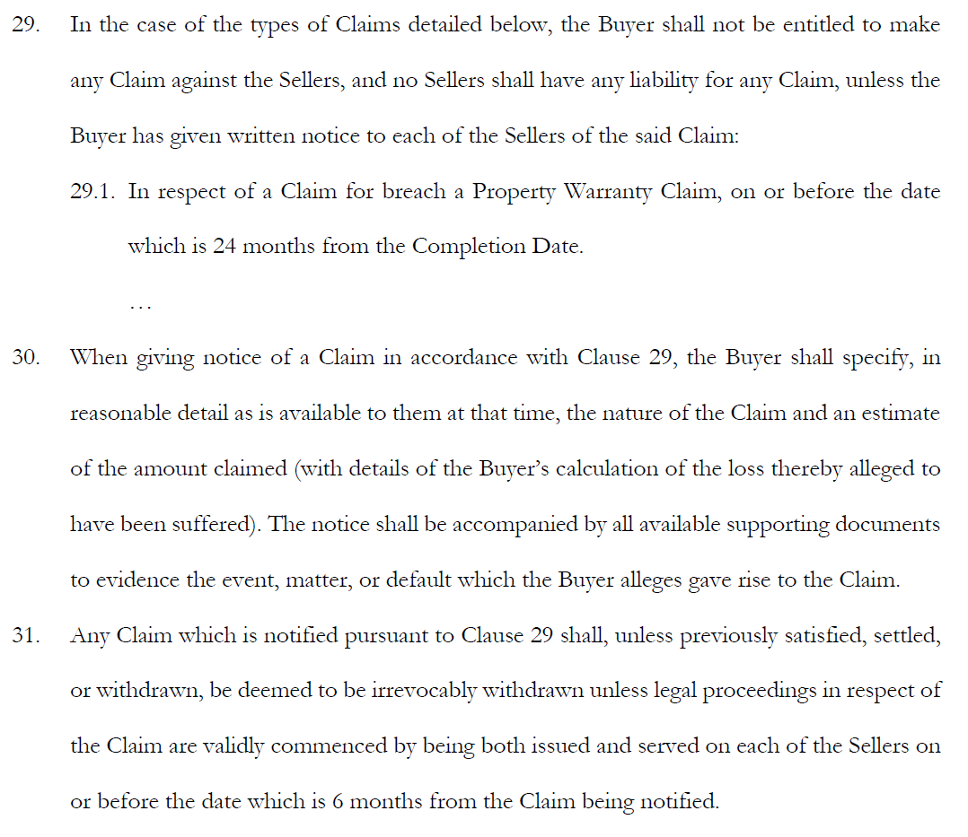
Exercise: sample time bar provision
Notes:
Remember that, properly speaking, the “true” principles to be derived from the cases on notice provisions is that every notification clause turns on its own wording: always be careful with the exercise! See Forrest v Glasser [2006] 2 Lloyd’s Rep 392 at [24].

Slide 7
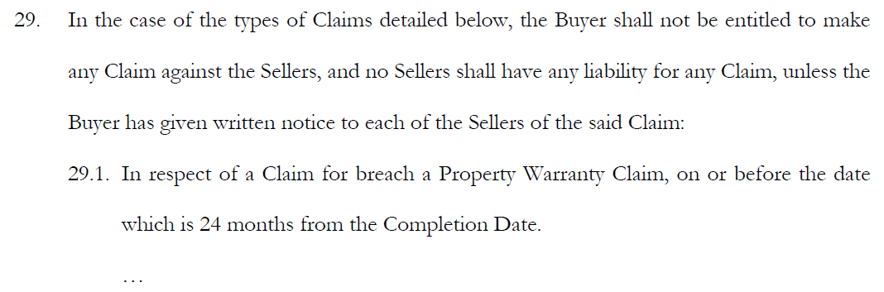
Exercise: sample time bar provision
Identity of parties to be notified
Calculation of dates
Notes:
The “no Sellers shall have any liability for any Claim” part is also relevant – but in the interests of time it is excluded from this talk! Drop me an email if you want to discuss what function that part of the clause is intended to serve.

Slide 8
Deemed delivery clauses
Most well-drafted contracts will have quite extensive notification clauses. Should be strictly followed, in terms of both form of notices and deemed delivery dates.

Slide 9
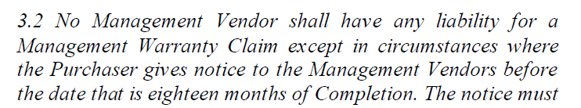
Deemed delivery clauses
Zayo Group International Limited v Ainger [2017] EWHC 2542 (Comm) at [67] onwards.
Irrelevant that the person does not stay at the address any longer, or that it is unlikely to come to their attention.

Slide 10
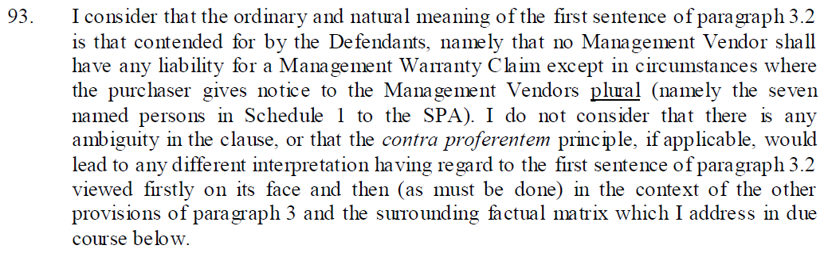
Multiple parties to be notified
Risk that failing to notify one party leads to claims against all parties failing: Zayo Group International Limited v Ainger [2017] EWHC 2542 (Comm).

Slide 11
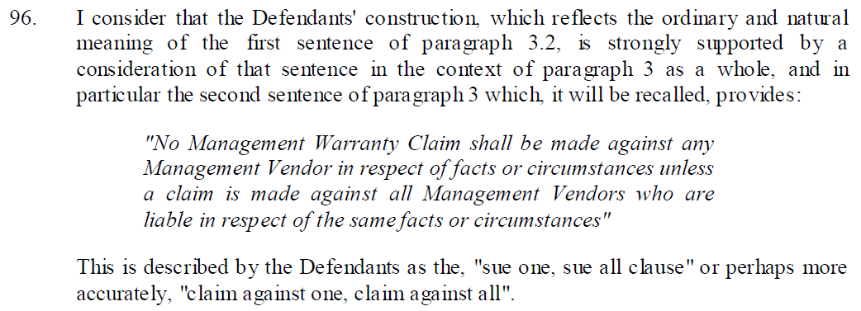
Multiple parties to be notified
Risk that failing to notify one party leads to claims against all parties failing: Zayo Group International Limited v Ainger [2017] EWHC 2542 (Comm).

Slide 12
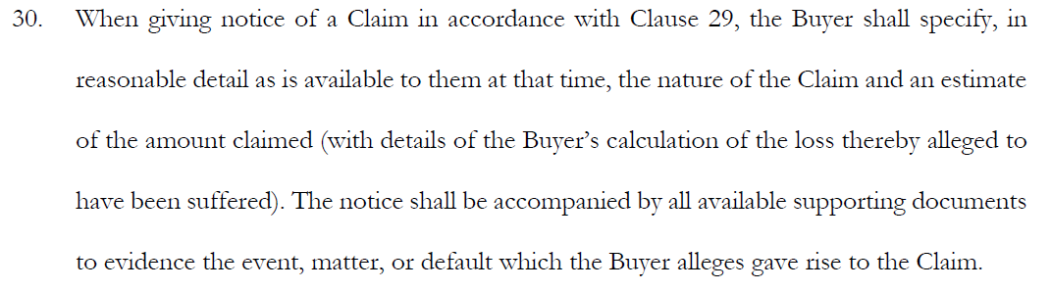
Exercise: sample time bar provision
Notice “of a Claim”
“Estimate” provisions
“Reasonable detail” provisions
“Supporting documents” provisions

Slide 13
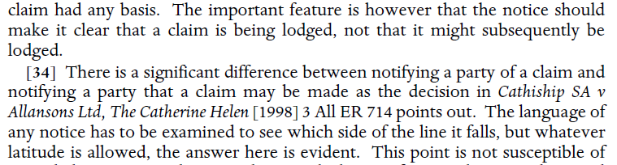
Notice “of a Claim”
Notice must make it clear that a claim is actually being made, rather indicating a possibility that a claim may yet be made: Lamiates Acquisition v BTR Australia Ltd [2004] 1 All ER (Comm) 737 at [33].

Slide 14
“Reasonable detail” provisions
Commercial purpose of reasonable detail provisions forms the basis of what is required to meet them. Judged by reference to the language used having regard to nature of and background to the transaction: ROK Plc (in administration) v S Harrison Group Ltd [2011] EWHC 270 (Comm) at [62].

Slide 15
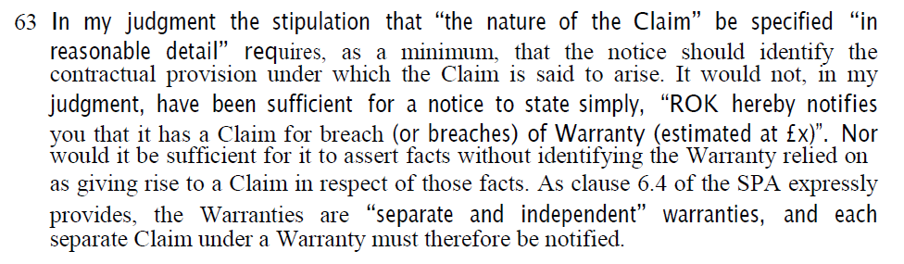
“Reasonable detail” provisions
Historically required a minimum of identifying the contractual provision under which a claim is said to arise: ROK Plc (in administration) v S Harrison Group Ltd [2011] EWHC 270 (Comm) at [63].

Slide 16
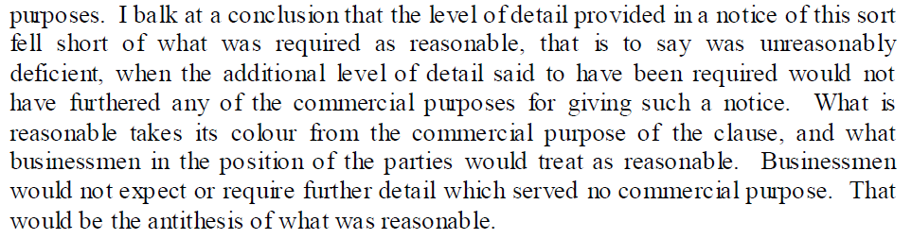
“Reasonable detail” provisions
If complaining about a notice lacking reasonable detail, expectation to show what commercial purpose those further details would serve: Dodika Ltd v United Luck Group Holdings Ltd [2021] EWCA Civ 638 at [46].
Notes:
Popplewell LJ

Slide 17
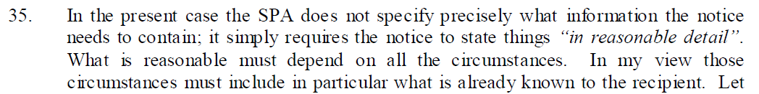
“Reasonable detail” provisions
Assessment of reasonableness depends on what is already known to the recipient: potentially no need to convey information already known, Dodika Ltd v United Luck Group Holdings Ltd [2021] EWCA Civ 638 at [35].

Slide 18
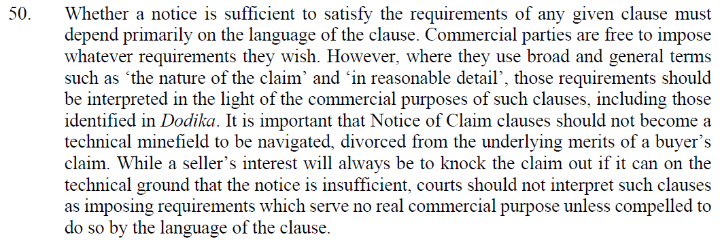
“Reasonable detail” provisions
A loosening of “reasonable detail” obligations? Drax Smart Generation Holdco Limited v Scottish Power Retail Holdings Limited [2024] EWCA Civ 477 at [50].
Notes:
Males LJ.

Slide 19
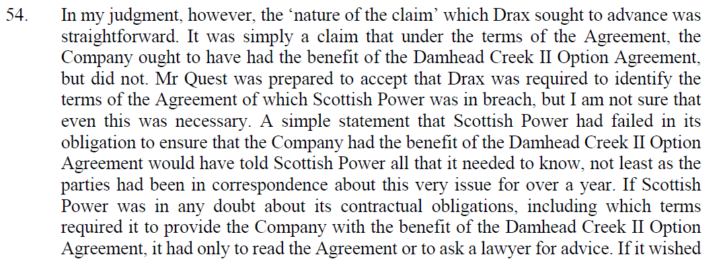
“Reasonable detail” provisions
A loosening of “reasonable detail” obligations? Drax Smart Generation Holdco Limited v Scottish Power Retail Holdings Limited [2024] EWCA Civ 477 at [54].

Slide 20
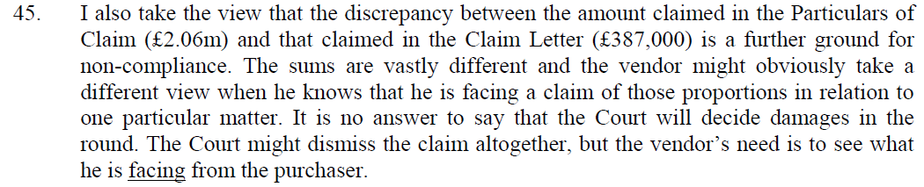
“Estimate” provisions
“Estimate” provisions potentially finnicky – useful starting point is Highwater Estates Ltd v Graybill [2009] EWHC 1192 (QB) at [45]-[48].

Slide 21
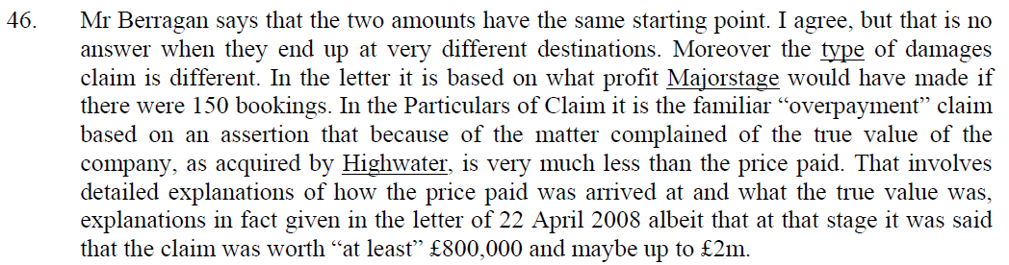
“Estimate” provisions
“Estimate” provisions potentially finnicky – useful starting point is Highwater Estates Ltd v Graybill [2009] EWHC 1192 (QB) at [45]-[48].

Slide 22
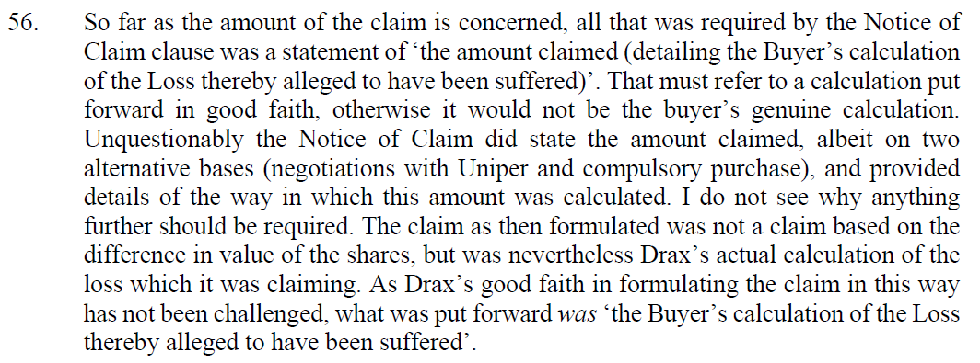
“Estimate” provisions
Simple factual assessment of whether estimate was a calculation put forward in good faith? Drax Smart Generation Holdco Limited v Scottish Power Retail Holdings Limited [2024] EWCA Civ 477 at [56] and [58].

Slide 23
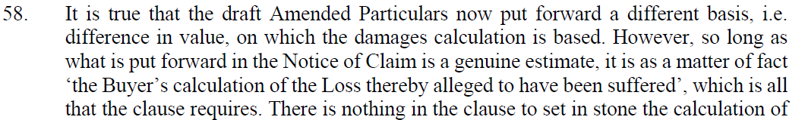
“Estimate” provisions
Simple factual assessment of whether estimate was a calculation put forward in good faith? Drax Smart Generation Holdco Limited v Scottish Power Retail Holdings Limited [2024] EWCA Civ 477 at [56] and [58].
Notes:
Reasoning appears to be followed in Learning Curve (Ne) Group Limited v Lewis [2025] EWHC 1889 (Comm) from [247].

Slide 24
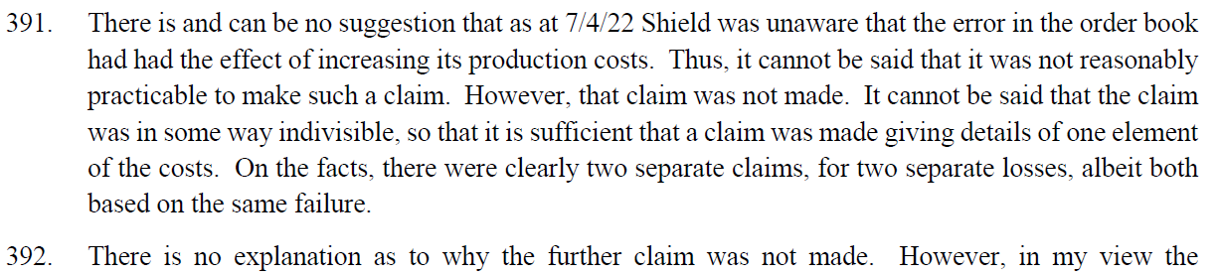
“Estimate” provisions
Is a departure from an “estimate” by advancing a reformulated claim a failure to notify that different claim? Presbar Diecastings Limited v G W Atkins & Sons Limited [2026] EWHC 399 (Ch) at [389]-[395].

Slide 25
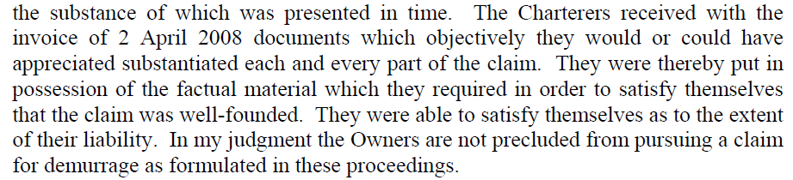
“Supporting documents” provisions
“Supporting documents” requirements: The Abqaiq [2011] EWCA Civ 1127 at [65].

Slide 26
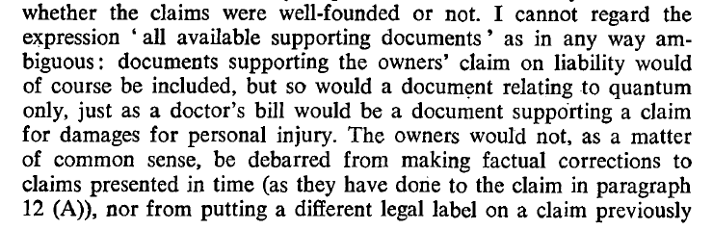
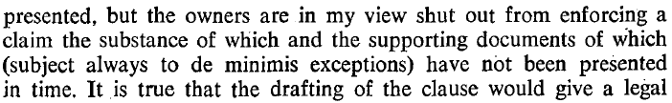
“Supporting documents” provisions
“Supporting documents” vs “All supporting documents”: The Oltenia [1982] 1 Lloyd’s Rep 448.

Slide 27
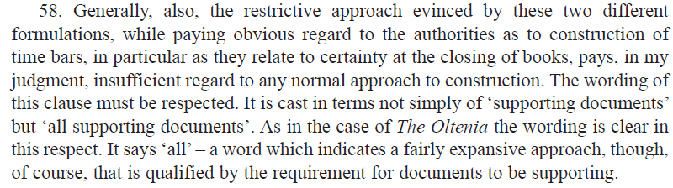
“Supporting documents” provisions
“Supporting documents” vs “All supporting documents”: Mur Shipping BV v Louis Dreyfus Company Suisse SA [2019] 2 CLC 757 at [58].

Slide 28
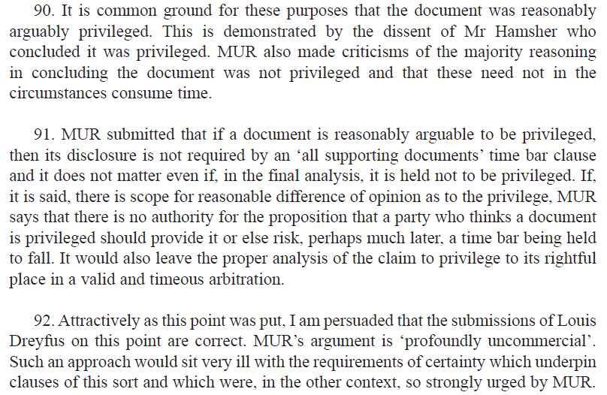
“Supporting documents” provisions
“Supporting documents” and arguable privilege: Mur Shipping BV v Louis Dreyfus Company Suisse SA [2019] 2 CLC 757 from [89].

Slide 29
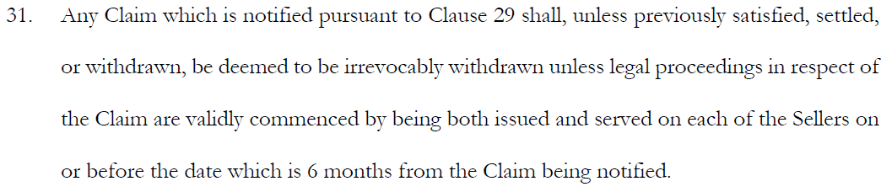
Exercise: sample time bar provision
Deemed service of proceedings in the context of time bars

Slide 30
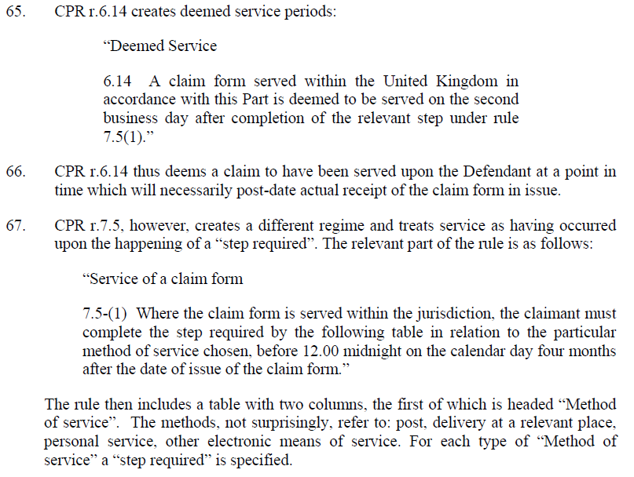
Service of proceedings
Deemed service under CPR 6.14 or factual service under CPR 7.5?

Slide 31
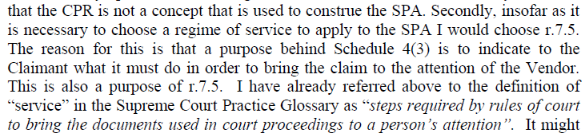
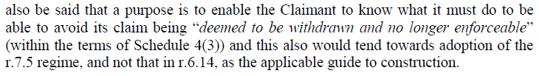
Service of proceedings
Deemed service under the CPR not applicable to such clauses – Ageas (UK) Limited v Kwik-Fit (GB) Limited [2013] EWHC 3261 (QB) at [79].

Slide 32
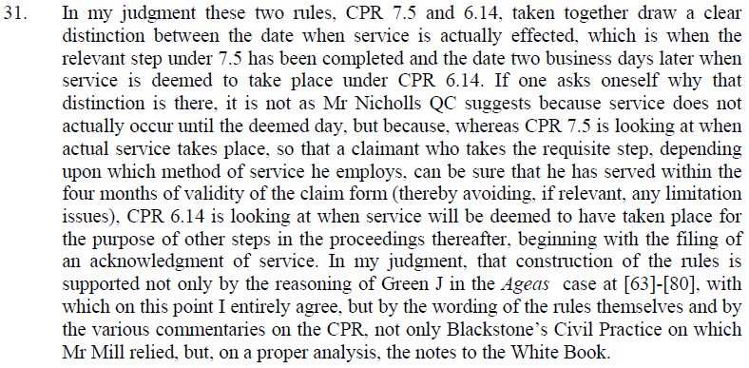
Service of proceedings
Reasoning followed in this respect – T&L Sugars Limited v Tate & Lyle Industries Limited [2014] EWHC 1066 (Comm) at [31].

Slide 33
Service of proceedings
Obiter criticism of this state of affairs – Brightside Group Limited v RSM UK Audit LLP [2017] EWHC 6 (Comm) from [21]-[30].

Slide 34

Thank you for joining
Jian Jun (JJ) Liew
jj.liew@newsquarechambers.co.uk

