Slide 1

s.21 & Renters’ Rights Act:
Recovering Possession
PROPERTY
DATE: Wednesday 5th November 2025
TIME: 11:00 – 12:00
LOCATION: Online via Zoom

Slide 2

INTRODUCTION

Slide 3
s.21 Notices &
The Renters’ Rights Act 2025:
Recovering Possession
For information only. Does not constitute legal advice. All rights reserved.

Slide 4


CHLOE RIXON
RABBY FOZLAY
2021
2023

Slide 5



s.21 NOTICES

Slide 6
s.21 Notices
What is needed for a s.21 Notice?
Common issues
Can these issues can be remedied?

Slide 7
What is needed for a s.21 Notice
When are they used?
Key pre-conditions:
  Tenancy deposit
  EPC (Energy Performance Certificate)
  Gas Safety Certificate
  How to Rent Guide
  HMO Licence
Under what statute are they governed?

Slide 8
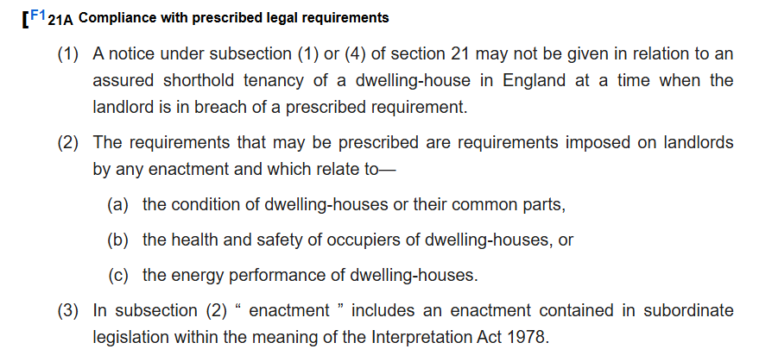
Statutory Framework

Slide 9
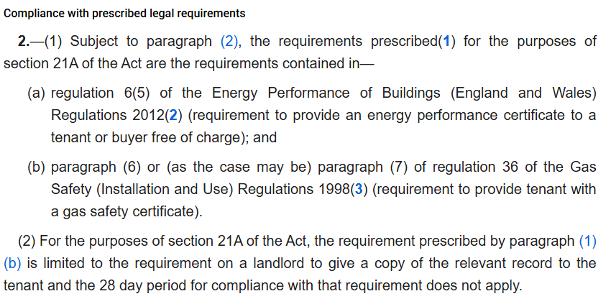
Statutory Framework

Slide 10
Statutory Framework
Tenancy deposit – sections 213-215 of the Housing Act 2004
EPC (Energy Performance Certificate) - regulation 6(5) of the Energy Performance of Buildings (England and Wales) Regulations 2012
Gas Safety Certificate - paragraph (6) or (as the case may be) paragraph (7) of regulation 36 of the Gas Safety (Installation and Use) Regulations 1998
How to Rent Guide – Regulation 3 of the Assured Shorthold Tenancy Notices and Prescribed Requirements (England) Regulations 2015

Slide 11
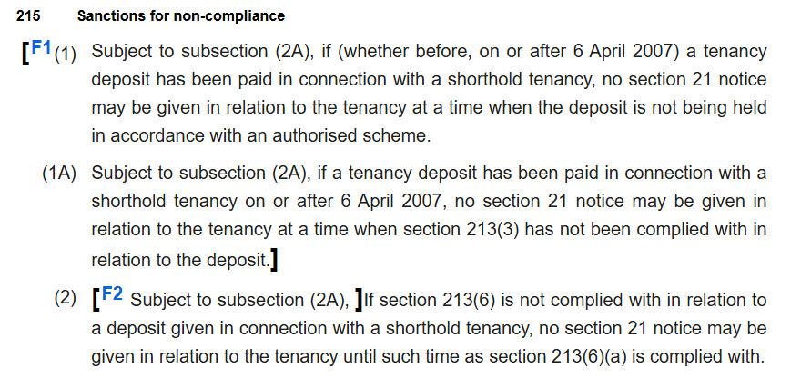
Statutory Framework – Tenancy Deposit

Slide 12
Statutory Framework – Tenancy Deposit
Requirements:
  Placing the deposit in an authorised tenancy deposit scheme from the time it is received;
  Comply with the scheme’s initial requirements within 30 days of receiving the deposit; and
  Providing the prescribed information to the tenant within 30 days of receiving the deposit.
  Additionally, not taking a deposit of over 5 weeks equivalent in rent – Tenant Fees Act 2019.

Slide 13
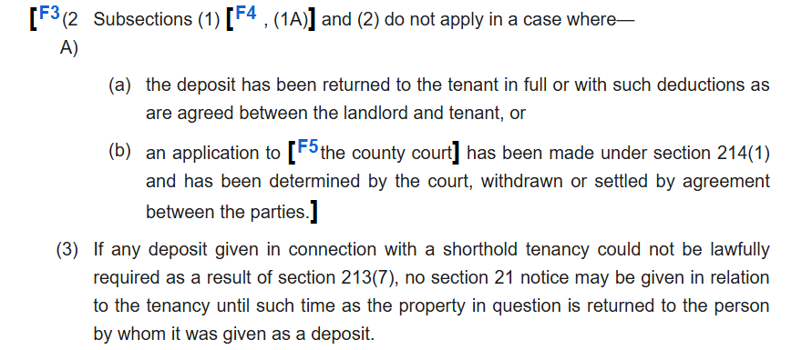
Tenancy Deposit – Can it be remedied?

Slide 14
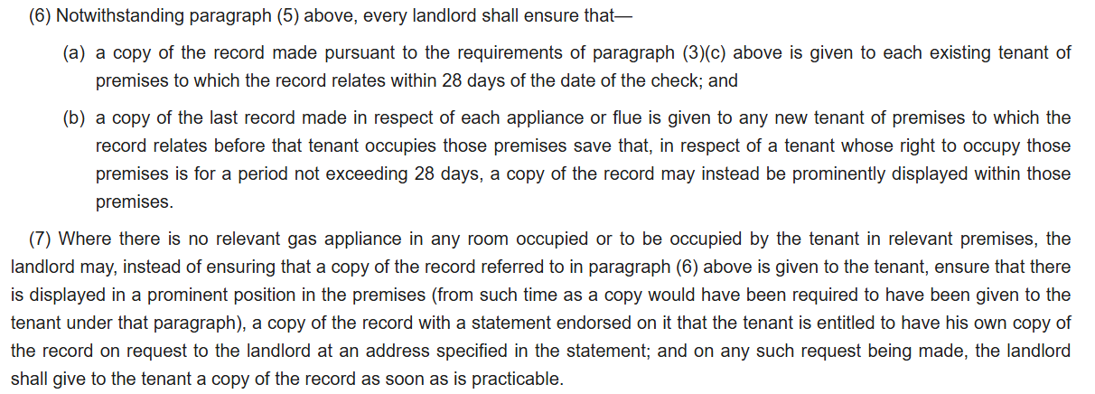
Statutory Framework – Gas Certificate

Slide 15
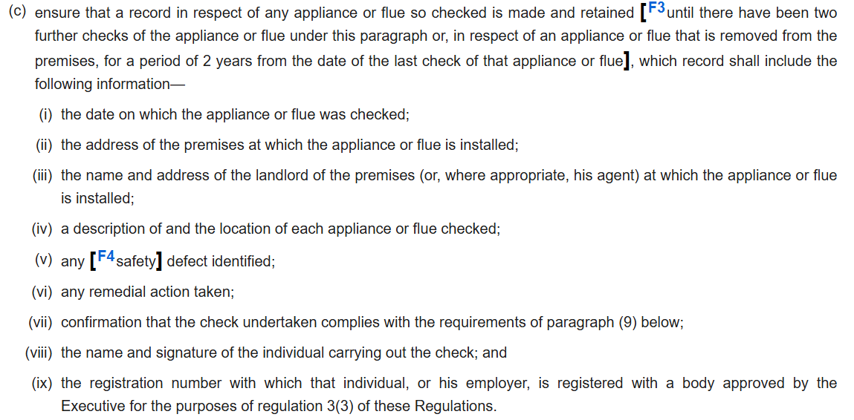
Statutory Framework – Gas Certificate

Slide 16
Gas Certificate – Can it be remedied?
Three cases:
  Trecarrell House Ltd v Rouncefield (2020) EWCA Civ 760
  Byrne v Harwood-Delgardo. HHJ Bloom. Luton County Court. 21 June 2022
  Cassell & Cassell v Sidhu & Sidhu. HHJ Clarke. County Court at Reading. 9 October 2025
Latter two are arguably conflicting – though slightly different facts – but neither are binding.
What is clear, is that we are in a continuing space of uncertainty!

Slide 17
Gas Certificate – Can it be remedied?
Case: Trecarrell House Ltd v Rouncefield [2020] EWCA Civ 760
Outcome: the key to the appeal was the meaning of Regulation 2(2) of the Assured Shorthold Tenancy Notices and Prescribed Requirements (England) Regulations 2015. In short, the Court of Appeal lead judgment (on a 2:1 split decision) seemed to find that both 36(6)(a) and 36(6)(b) of the Gas Safety (Installation and Use) Regulations 1998 are applied by reg 2(1) and (2), but the time limits are disapplied.

Slide 18
Gas Certificate – Can it be remedied?
Case: Byrne v Harwood-Delgardo. HHJ Bloom. Luton County Court. 21 June 2022
Outcome: the issue on appeal was whether the absence of a gas safety certificate at the start of the tenancy prevented a s.21 Notice being served. Ultimately, it was held that it did.
This decision is not binding.

Slide 19
Gas Certificate – Can it be remedied?
Case: Cassell & Cassell v Sidhu & Sidhu. HHJ Clarke. County Court at Reading. 9 October 2025
Outcome: the Gas Safety Certiifcate at the start of the tenancy left the box for “Details of Customer/Landlord” blank, so failed to comply with regulation 36(3)(c)(iii) of the Gas Safety Installation and Use Regulations 1998. However, it was found that where the two certificates for the following two years were valid, it meant that the failure to provide the initial valid certificate could be remedied. So here s.21 Notice could be valid because of the two valid certificates prior to the s.21 Notice.

Slide 20
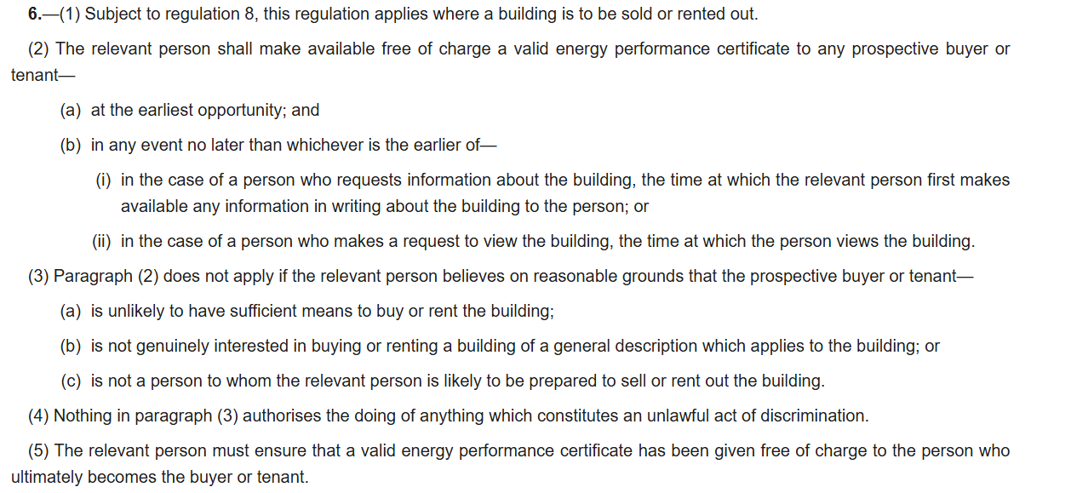
Statutory Framework – EPC

Slide 21
EPC – Can it be remedied?
Shock – even more uncertainty!
Lack of EPC case authority, so the gas safety certificate cases are used by analogy.
Notably though, Regulation 2(2) Assured Shorthold Tenancy Notices and Prescribed Requirements (England) Regulations 2015 only refers to the time limitation for providing gas safety certificates not applying, and does not make reference to EPCs…

Slide 22
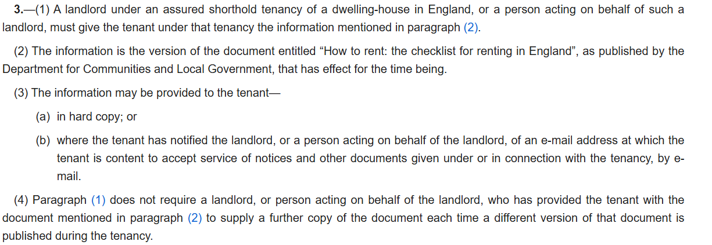
Statutory Framework – How to Rent Guide

Slide 23

RENTERS’ RIGHTS ACT 2025

Slide 24
Notes:
- Amending Act

Slide 25
Abolishing s.21; Assured Shorthold & Fixed-Term Tenancies (ss.1 - 2)
Expanding Grounds for Possession (ss.3 - 5)
Limiting Rent Increases & Deposits etc. (ss.6 - 9)
Implying covenant not to unreasonable withhold consent to Pets (s.11)
Requiring provision of prescribed written information (s.12)
Strengthening penalties for non-compliance & enforcement powers (ss. 15 - 16; 102 - 136)
Prohibiting discrimination against DSS tenants/children & ‘bidding wars’ (ss.33 - 55; 56 - 57)
Creation of New Ombudsman & PRS database (ss.64 - 70; 75 - 96)
Introducing Decent Home Standards & Awaab’s Law (ss. 100 - 101)
Notes:
149 x sections; 6 x Schedules
Lots to unpack
Still getting to grips

Slide 26
FOCUS:
1. Tenancies
2. Grounds for Possession
Notes:
- Focus on Headline Changes
- Cannot look in detail due to time
- Overview of most general issues

Slide 27
1. Tenancies

Slide 28
⚠️
COMMENCEMENT DATE:
[TBC]
See: s.145, RRA 2025 and Schedule 6
Notes:
- Only kick in on commencement date
- No set date
BUT:
- Govt press release: rolled out “in the coming weeks.”
- Industry pushing for 6 months from now – Apr 26 (Financial Year)
- Rumour mill: “Spring/May 2026”
- Remember, Remember change is potentially round the corner

Slide 30
1 – Assured Tenancies
No Fixed Term
Only Periodic:
28 days or less (i.e. weekly / fortnightly)
Monthly

Slide 32
No Assured Shorthold Tenancies (ASTs)
Only Assured Tenancies

Slide 36
Assured Tenancies
Let as Separate Dwelling (i.e.not including lodgers)
Individual
Principal Home
Not excluded: (ss.1(2) – (6); and Sch 1 HA 1988
High Rent (>£100,000 p.a) or Low Rent (≤ £250 p.a or ≤£1,000 p.a in Greater London)
Business Tenancies; Licensed Premises; Agricultural tenancies etc.
Long tenancies (>21 years or 7 - 21 years granted pre-RRA 2025) (see: s.31 RRA 2025)
Student or Homeless Accommodation (see: s.32 RRA 2025)

Slide 37
SUMMARY
- No Fixed Term
Only Periodic Tenancies
(≤ 28 days or monthly)
- No Assured Shorthold
Only Assured Tenancies

Slide 38
2. Grounds for Possession

Slide 39
⚠️
COMMENCEMENT DATE:
[TBC]
Transitional provisions: Schedule 6 RRA 2025
Notes:
- Only kick in on commencement date
- No set date
BUT:
- Govt press release: rolled out “in the coming weeks.”
- Industry pushing for 6 months from now – Apr 26 (Financial Year)
- Rumour mill: “Spring/May 2026”
- Remember, Remember change is potentially round the corner

Slide 40
Tenant’s Notice to Quit

Slide 41
⚠️
AT LEAST TWO MONTHS
Unless shorter period agreed by the Landlord in writing
Tenant’s Notice to Quit:
Notes:
- Only kick in on commencement date
- No set date
BUT:
- Govt press release: rolled out “in the coming weeks.”
- Industry pushing for 6 months from now – Apr 26 (Financial Year)
- Rumour mill: “Spring/May 2026”
- Remember, Remember change is potentially round the corner

Slide 42
s.21 Abolished
Renters’ Rights Act 2025

Slide 44
NO MORE s.21
ONLY ss.7/8

Slide 45
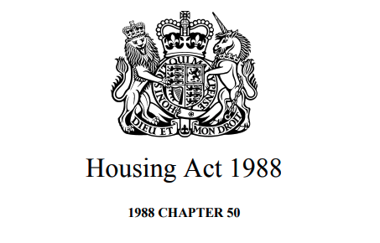
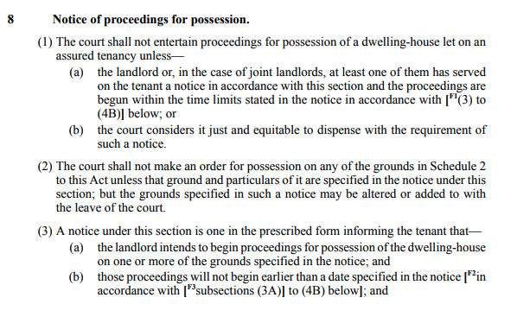
ss.7/8 Requirements

Slide 46
ss.7/8 Requirements:
Schedule 2 Grounds met
s.8 Notice served
Proceedings started within time limits

Slide 47
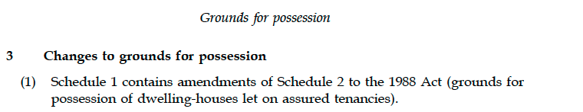
Changes to Schedule 2 HA 1988

Slide 48
New/Amended Grounds: (Schedule 1, Renters’ Right Act 2025)
  Includes:
  Ground 1: Occupation by Landlord or family (after 1 year)
  Ground 1A: Landlord Intends to Sell (after 1 year)
  Ground 1B: Possession After Rent-to-Buy Agreement
  Ground 2ZA - 2ZD: where leasehold ended and Landlord does not own freehold
  Ground 4A: Student Accommodation
  Ground 5A - H: Agricultural Workers; Employees; Supported Accommodation; Homelessness
  Ground 6: Re-development
  Ground 6B: Enforcement Action
  Ground 8: Serious Rent Arrears – 13 weeks or 3 months

Slide 49
Ground 1: Occupation by Landlord or family
para 2, Schedule 1, Renters’ Rights Act 2025:

Slide 50
s.13, Renters’ Rights Act 2025: Restricted Period
[…]

Slide 51
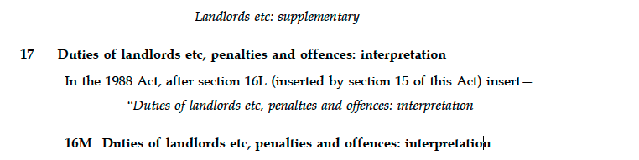
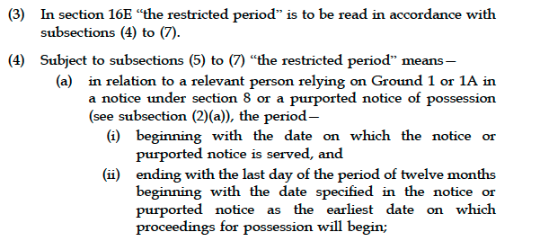
s.17, Renters’ Rights Act 2025: Restricted Period
[…]

Slide 52
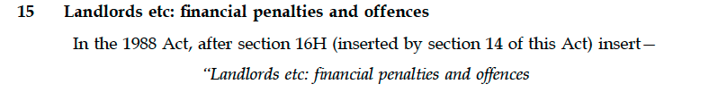
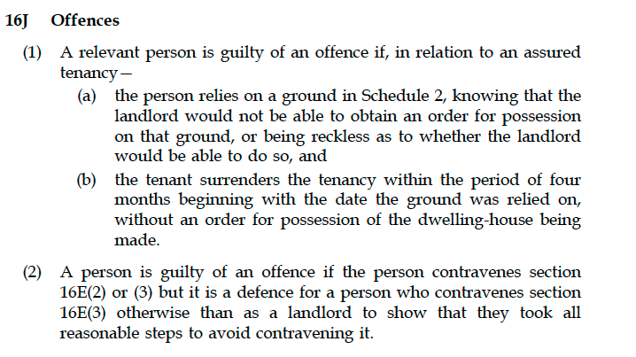
s.15, Renters’ Rights Act 2025: Offence
[…]

Slide 53
Ground 1: Occupation by Landlord or Family
Only 1 year after tenancy began
Only or Principal Home:
  Landlord; Spouse/Civil Partner or “Common Law” Partner
  Landlord’s parents; grandparent; sibling; child/grandchild
  Spouse’s/Civil Partner’s or “Common Law” Partner’s child/grandchild
  Half-relations included
Cannot let or market during “restricted period” (i.e. 1 year)
Otherwise, guilty of offence (prosecuted or penalty upto £40,000)
Minimum Notice Period: 4 months
Notes:
Earliest date for possession: 1 year after tenancy began

Slide 54
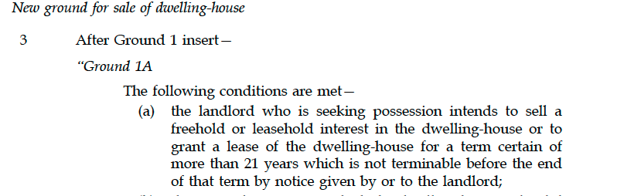
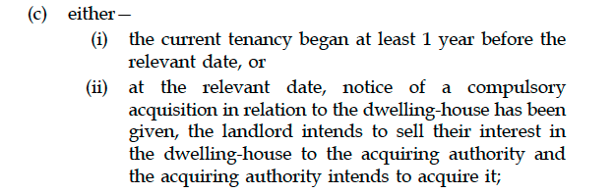
Ground 1A: Landlord Intends to Sell
Para 3, Schedule 1, Renters’ Rights Act 2025:
[…]

Slide 55
s.13, Renters’ Rights Act 2025: Restricted Period
[…]

Slide 56
s.17, Renters’ Rights Act 2025: Restricted Period
[…]

Slide 57
s.15, Renters’ Rights Act 2025: Offence
[…]

Slide 58
Ground 1A: Landlord Intends to Sell
Only 1 year after tenancy began or if compulsory purchase
Includes granting lease
Cannot let or market during “restricted period” (i.e. 1 year)
Otherwise, guilty of offence (prosecuted or penalty upto £40,000)
Minimum Notice Period: 4 months

Slide 59
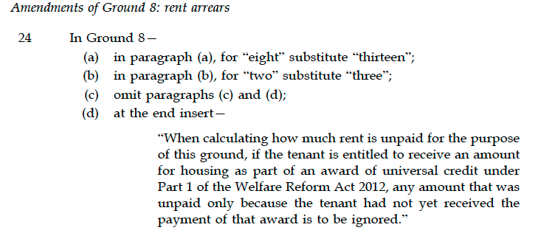
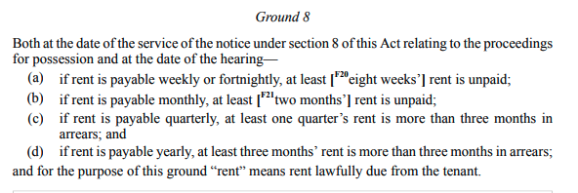
Ground 8: Serious Rent Arrears
para 24, Schedule 1, Renters’ Rights Act 2025:
Schedule 2, Housing Act 1988:

Slide 60
Ground 8: Serious Rent Arrears
13 weeks’ or 3 months’ rent outstanding
Minimum Notice Period: 4 weeks

Slide 61
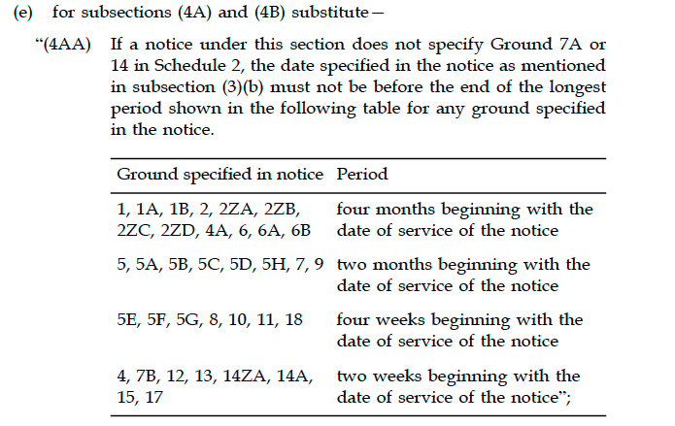
New Minimum Notice Periods
s.3(3)(e), Renters’ Rights Act 2025:
[…]

Slide 62
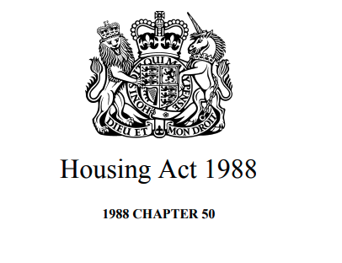

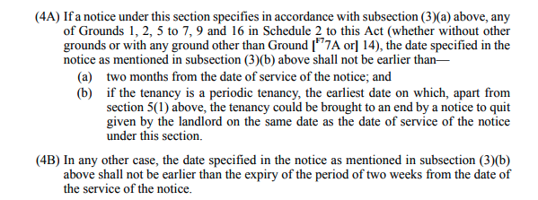
[…]

Slide 63
Minimum Notice Periods
4 categories: 4 months; 2 months; 4 weeks or 2 weeks
Grounds 1 & 1A: 4 months
Ground 8: 4 weeks
Ground 12 (breach other then non-payment of rent): 2 weeks

Slide 64
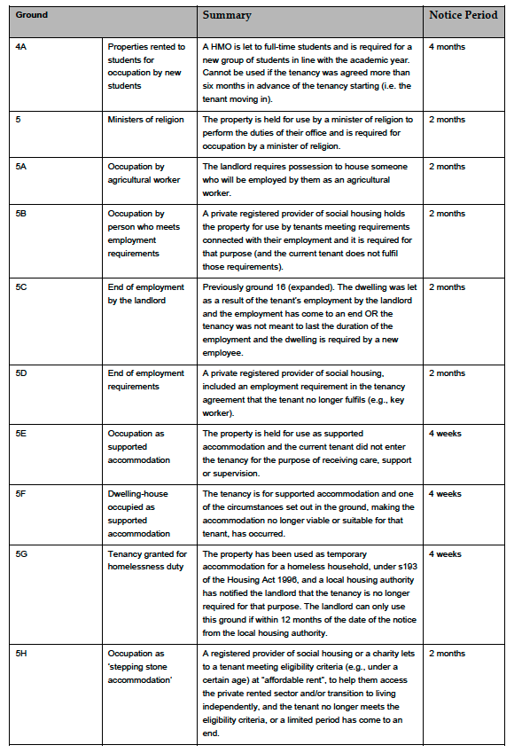
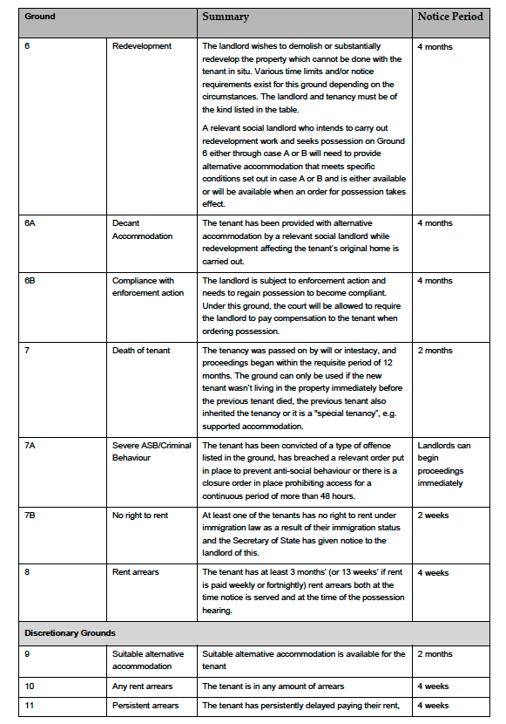
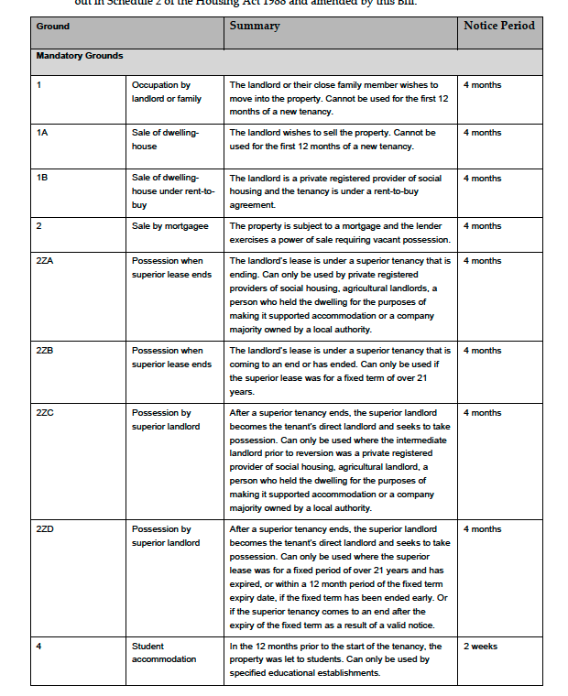
Existing Grounds

Slide 65
Existing Grounds
Explanatory Notes to *Bill*: here
15 January 2025: maybe outdated
Review all grounds. Not just those in RRA 2025.

Slide 66
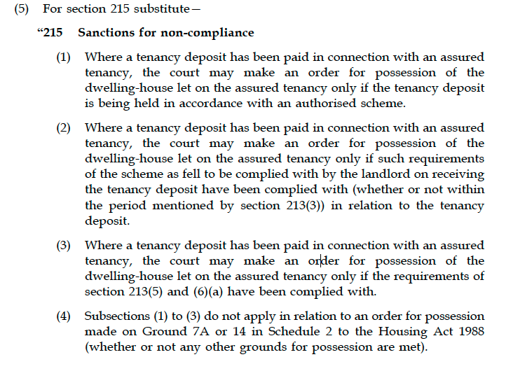
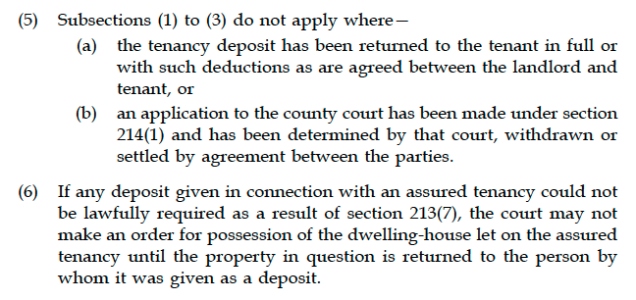
Deposit Rules
s. 26(5), Renters’ Rights Act 2025:

Slide 67
DEPOSIT RULES
Court can only grant possession, where:
Deposit paid and:
  held in authorised scheme
  s.213(3) HA 2004 initial requirements complied (at any time) with
  s.213 (5) and (6)(a) HA 2004 prescribed information given
Unless:
  Deposit returned in full or with agreed deductions
  s.214 HA 2004 application made to Court determined/withdrawn/settled
Court cannot grant possession if anything other than money held as deposit

Slide 68
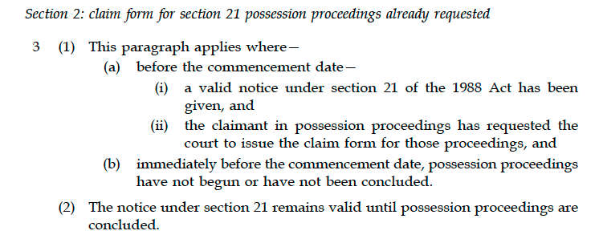
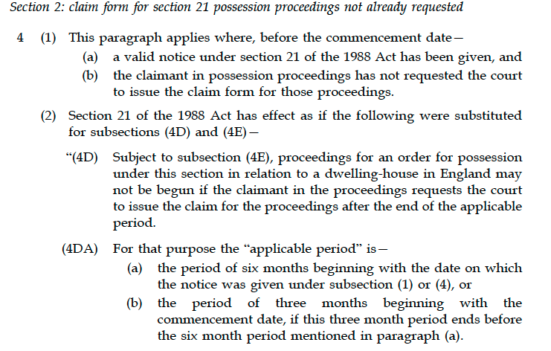
Transitional Period
Schedule 6, Renters’ Rights Act 2025:
[…]

Slide 69
Transitional Period
Can still use s.21 process, if before Commencement Date:
valid s.21 notice served & proceedings requested
But if only valid s.21 notice served, and no proceedings requested then:
Must request proceedings within “applicable period”:
  6 months of date of notice; or
  3 months of commencement date (if earlier)
e.g: Notice served in Jan 2026. Commencement date Feb 2026.
Proceedings must be requested by May 2026.

Slide 70
SUMMARY
No ASTs; only Assured Tenancies
No Fixed Term; only Periodic Tenancies
No s.21; only ss.7/8
New Grounds + Changes to Existing Grounds
New Deposit Rules for possession
Not yet commenced. Transitional Period.

Slide 71

Q&A
Thank you for joining
Chloe Rixon
Chloe.Rixon@newsquarechambers.co.uk
Rabby Fozlay
Rabby.Fozlay@newsquarechambers.co.uk

