Slide 1

The new normal?
Costs orders against drafting firms in probate disputes
TRUSTS, WILLS & ESTATES
DATE: Wednesday 29th October 2025
TIME: 11:00 – 12:00
LOCATION: Online via Zoom

Slide 2
Non-party costs in probate disputes
Basics
Procedure
Key cases
Other claims
Compulsory ADR
Practical tips
The new normal?

Slide 3
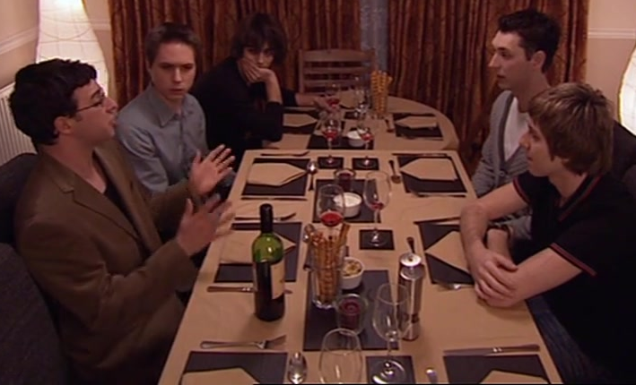
Basics: non-party costs
A costs order against the solicitor or will-writer that drafted the disputed will
Not initial party to
proceedings
Added to proceedings
for costs only

Slide 4
Procedure
Statutory basis: section 51 of the Senior Courts Act 1981
CPR r 46.2:
(1) Where the court is considering whether to exercise its power under section 51 of the Senior Courts Act 1981 (costs are in the discretion of the court) to make a costs order in favour of or against a person who is not a party to proceedings, that person must –
(a) be added as a party to the proceedings for the purposes of costs only; and
(b) be given a reasonable opportunity to attend a hearing at which the court will consider the matter further.
White Book notes at 46.2.2: such orders are exceptional, ie outside the usual run of cases
Also arguably CPR r 19.2(2): adding a party to existing proceedings

Slide 5

Key cases (i) – Deutsche Bank AG v Sebastian Holdings Inc
[2016] EWCA Civ 23
The ‘critical factor in each case is the nature and degree of his connection with the proceedings’ (21)
Not a cause of action – an exercise of costs discretion
Procedure and principles different to exercise of usual costs discretion
Exercise of discretion ‘consequent upon the outcome of the trial’ (22)
Rules of evidence do not apply
Facts of the case ‘not seriously open to challenge’ (26)

Slide 6

Key cases (ii) - Marley v Rawlings (Costs)
[2014] UKSC 51
‘8 However, this is not a case where it could possibly be right to ignore the position of the Solicitor. Indeed, there is, at least in terms of broad common sense, considerable attraction in the notion that the Solicitor should bear all the costs, in the sense that he was the person whose unfortunate error was responsible for the litigation […]
9 It was the error of the Solicitor which caused the problem that gave rise to the proceedings, as is reflected by the fact that the insurers accepted liability to Mr Marley for his costs in the Court of Appeal and the Supreme Court.’
Citing Re Bimson [2010] EWHC 3679 (Ch) and Gerling v Gerling [2010] EWHC 3661 (Ch).

Slide 7

Key cases (iii) – Leonard v Leonard (Costs)
[2024] EWHC 979 (Ch)
Court pronounced against a will for lack of capacity and want of knowledge and approval
Very critical of will drafter
‘92. In light of my judgment, the parties have invited me to include a provision in the Order to the effect that any party wishing to apply to the Court to join Irwin Mitchell to these proceedings for the purposes of making a non-party costs application against that firm should do so within three weeks of the Order. I confirm that I am content to make such an order’.

Slide 8
Key cases (iv) – Pead v Prostate Cancer UK
[2023] EWHC 3224 (Ch)
The Claimant brought a construction and rectification claim
The rectification claim failed but the construction claim succeeded
The will-writer, BBMW (in fact a successor practice) agreed to pay costs of construction but not rectification claim
This was ‘not such a clear cut case’ as in Marley v Rawlings (34)
BBMW was not the sole cause of the litigation but:
‘the acts and in particular the omissions of BBMW did significantly contribute to the circumstances giving rise to the rectification claim’ (26)
As well as its ‘responses to the claim’ fuelled the pursuit of the claim (36)
As BBMW was not solely responsible it was ordered to make a contribution, assessed in the round as 60% of all parties’ costs of the entire litigation, reflecting ‘the degree to which BBMW may fairly be said to have by its conduct and omissions been responsible for the claim’ (40)

Slide 9
Other claims (i)
Clear authority for use of this process in probate claims
As in Pead, in construction / rectification claims as well
Logically this could extend liability to the drafters of any document
What about the Inheritance (Provision for Family and Dependants) Act 1975?
If any party is sufficiently closely connected and they caused or contributed to the litigation, they may well be held liable, if only for part of the costs

Slide 10
Other claims (ii)
What about negligence?
Not a cause of action being advanced
As set out in Pead:
‘35. I have considered whether the right course would be to dismiss the application against GWCA and leave the Claimant and the family members, if so advised, to bring a professional negligence claim against GWCA. I have come to the clear conclusion that this would not be a fair and just outcome. BBMW was put on notice in March 2022 that professional negligence was being alleged against it and it notified its insurers accordingly’.
Compare with Ivey v Lythgoe [2025] EWHC 2325 (Ch) at 20 (seemingly requiring causation / quantum to be determined first in negligence claim)

Slide 11
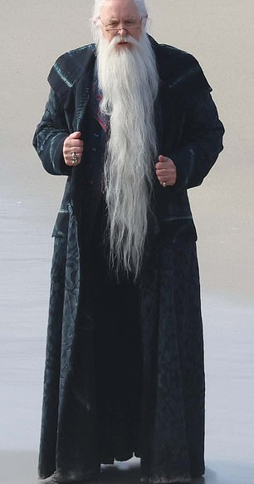
Compulsory ADR (i)
What if you want the non-party to mediate before findings of fact are made?
In Ivey v Lythgoe [2025] EWHC 2325 (Ch), an attempt was made to join a non-party before trial and to order them to mediate
HHJ Paul Matthews: not appropriate to join a non-party before findings of fact made:
‘If this probate/rectification claim were tried out and the claimants were unsuccessful, it would simply not be appropriate to engage the summary procedure provided for by section 51, so long as the respondent resisted liability.’ (20)

Slide 12
Compulsory ADR (ii)
However, a negligence claim was joined to a probate claim and mediation was ordered:
‘I consider that this tripartite litigation cries out for mediation. There is no new law involved, and the essential disputes of fact are both clear and not numerous. The important documents have already been disclosed. The value of the claims will quickly be exceeded by the costs of a trial. The best chance of resolving the matter will come earlier, when fewer costs have been incurred, compared to later. The risks for each party of going on with the litigation will be an important consideration at the mediation. Two of the three parties have already agreed to mediate, and the arrangements have been made’ (26)

Slide 13
Practical tips – claimant
Think about non-party costs before trial:
  Warn the non-party at the pre-action stage
  Consider joinder
  Do you need to issue negligence proceedings?
  Consider ADR
  Consider making an offer
Think creatively about who might could be a target for non-party costs:
  Solicitors / will-writers that draft a will
  Solicitors / will-writers that fail to draft a will
  Other professional advisers
  Family members – both as drafters and those involved in the process
  Puppeteers
Keep the non-party involved throughout proceedings
It may be necessary to ‘walk the tightrope’
Even your failure at trial may not prevent some costs recovery

Slide 14
Practical tips – defendant
The obvious one: if you have to settle, sooner may be better than later
Behave well during the pre-action phase
Claimants aren’t the only ones who can make offers
You may be able to obtain a right to attend or make submissions at trial
You can fight a non-party costs application on the merits
You can also fight a non-party costs application on orthodox costs grounds
Can you play the negligence card?

Slide 15
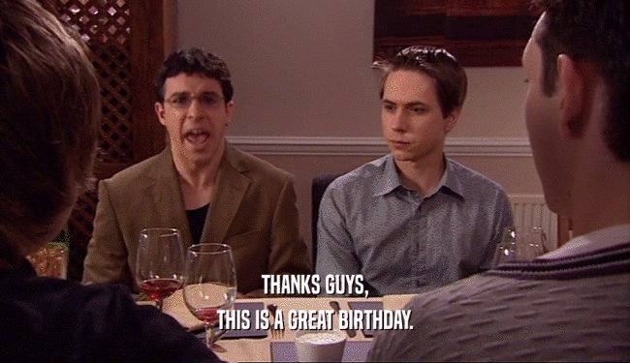
The new normal?
Number of authorities in recent years where non-party costs have been sought or obtained
Importantly – many settle, so likely dozens if not hundreds of additional settlements
True where a party is successful or unsuccessful
However, only where a non-party is ‘responsible for the litigation’ , in whole or in part
Compulsory ADR may be decisive

Slide 16

Any questions?
James McKean
James.McKean@newsquarechambers.co.uk

