Slide 1
Service Charge Disputes & Forfeiture
Pitfalls, Practicalities, and Procedure
DATE: Wednesday 23 April 2025
TIME: 11am - 12pm
LOCATION: Zoom

Slide 2
INTRODUCTION

Slide 3
LAURA WEBSTER
RABBY FOZLAY
2017
2023

Slide 4
1. Service Charge Disputes
Residential:
2. Forfeiture
For information only. Does not constitute legal advice. All rights reserved.

Slide 5
SERVICE CHARGE DISPUTES

Slide 6
PITFALLS

Slide 7
Q1:
Are the sums recoverable?
Never assume that they are…

Slide 8
“the Lease is the Lease is the Lease”
Start with the Lease

Slide 9
Q1: Are the sums recoverable under the Lease?
Rechargeable as Service Charge
e.g Caretaking/Concierge; Playground; Structural Defects; Charges
Repair or Improvement
Building v Estate Costs
Notes:
Each lift differently drafted
Assume not recoverable unless entitlement found in lease

Slide 10
Sweeper Clause
Holland Park Management Company Limited v Dell
[2023] EWCA Civ 1460
The London Borough of Tower Hamlets -v- Lessees of Brewster House and Malting House
[2024] UKUT 193 (LC)

Slide 11
Ordinary principles of contractual interpretation apply: Arnold v Britton [2015] UKSC 36
Sweeper clauses construed on the basis of what a reasonable person would have intended the language to mean at the time lease entered into
Specific provisions that precede sweeper clause are "the best indication" of what it might include: at [48] per Falk J in Holland Park (supra)

Slide 12
Q2:
Are the sums recoverable
under statute?

Slide 13
Limitation Act 1980
6 years = if reserved as rent
s.19 Limitation Act 1980
Re 3, 12, 23 and 29 St Andrew’s Square LON/00AW/NSI/200/0054, LVT
12 years = if long lease
s.8(2) Limitation Act 1980

Slide 14
ss.18 - 30
Landlord and Tenant Act 1985
(“LTA 1985”)

Slide 15
s.19 LTA 1985
Are the sums reasonable?

Slide 16
Q2: Are the sums recoverable under statute?
s.19 LTA 1985 – reasonableness
Reasonably incurred
e.g evidence of requirement for works; reports; surveys etc.
Reasonable standard
e.g. roof still leaks and consideration of amount

Slide 17
s.20 LTA 1985
Consultation Requirements

Slide 18
Q2: Are the sums recoverable under statute?
s.20 LTA 1985 - Consultation requirements:
Qualifying Set of Works = any leaseholder to pay >£250
Including under a Qualifying Long Term Agreement (“QLTA”)
Services under QLTA = any leaseholder to pay >£100
e.g. Utilities; Building management; Services

Slide 19
Must comply with relevant requirements at:
Schedules 1 to 4
The Service Charges (Consultation Requirements) (England) Regulations 2003
OR
Be granted dispensation under s.20ZA LTA 1985

Slide 20
Otherwise capped at:
£250: qualifying works
£100: services under QLTA

Slide 21
But, do not despair
Dispensation is there.
s.20ZA LTA 1985 and “relevant prejudice”:
Daejan Investments -v- Benson [2013] UKSC 14;
Aster Communities -v- Chapman [2021] EWCA Civ 660;
Lambeth -v- Kelly [2022] UKUT 00290 (LC)

Slide 22
Q3:
Is there a valid demand under the contract?
London Borough of Brent v Shulem B Association Ltd [2011] EWHC 1663 (Ch)

Slide 23
Q3: Is there a valid demand under the Lease?
Correctly identity / “the Leaseholder”
See: Mannai [1997] UKHL 19 for curable defects
Service Charge Machinery
e.g Certificate; Apportionment; Estimate/Interim/Actual
Notice/Deemed Service provisions
correct address; registered post and time for service

Slide 24
Q4:
Is there a valid demand under statue?

Slide 25
Q4: Is there a valid demand under statute?
s.20B LTA 1985: 18 months rule from when costs incurred
see: Skelton -v- DBS Homes (Kings Hill) Ltd [2017] EWCA Civ 1139
s.21B LTA 1985: Summary of Rights and Obligations
Benwell Road RTM Co Ltd -v- Davies [2025] EWCA Civ 368
ss. 47 & 48 LTA 1987: Landlord’s Address
for both rent and service charge demands

Slide 26
Q5:
Is there any thing
else to consider?

Slide 27
Q5: Is there any thing else to consider?
Counterclaim: Historic Neglect / disrepair
further advice or evidence required?
Leaseholder position / response
evidence to prove/counter; expert evidence
Sums in dispute / ADR
tactical/strategic decision; compromise & settlement

Slide 28
Suggested Questions to Ask
Q1: Are the sums recoverable under the Lease?
Q2: Are the sums recoverable under statute?
Q3: Is there a valid demand under the Lease?
Q4: Is there a valid demand under statute?
Q5: Is there any thing else to consider?

Slide 29
Practicalities & Procedure

Slide 30
Q1:
Can the dispute be resolved outside of court?

Slide 31
Q1: Can the dispute be resolved outside of court?
Provision of statements of account
Check the requirements of the lease; ss.21 and 22 of the LTA 1985
Pre-Action Practice Direction

Slide 32
Q2:
Where should you commence proceedings?

Slide 33
Q2: Where should you commence proceedings?
The County Court
The First Tier Tribunal (FTT)
Wider costs jurisdiction
costs normally follow the event; track specific rules; contractual entitlement under CPR r 44.5; Chaplair Ltd v Kumari [2015] EWCA Civ 798
Can order a party to pay a service charge
Limited costs jurisdiction
Decisions are declaratory in nature
Termhouse (Clarendon Court) Management Ltd v Al Balhaa [2021] EWCA Civ 1881; s.27A(1)
Specialist expertise
Can raise matters of its own volition
Admiralty Park Management Company Limited v Ojo [2016] UKUT 421 (LC)

Slide 34
Transfer from the County Court to the FTT
s. 176A of the Commonhold and Leasehold Reform Act 2002
“double-hatting”

Slide 35
Q3:
Are the legal costs going to be recoverable?

Slide 36
Can legal costs be recovered against the tenant?
Freeholders of 69 Marina, St Leonards-On-Sea v Oram [2011] EWCA Civ 1258
“…to pay all expenses including solicitors costs and surveyors’ fees incurred by the Landlord incidental to the preparation and service of a notice under Section 146 of the Law of Property Act 1925 or incurred in contemplation of proceedings under Section 146…of the Act…”
Kensquare Ltd v Boakye [2021] EWCA Civ 1725
“To pay all costs charges and expenses (including Solicitors’ costs and Surveyors’ fees) incurred by the Lessor for the purpose of or incidental to the preparation and service of a Notice under Section 146 of the Law of Property Act 1925”

Slide 37
Can legal costs be recovered against the tenant?
Indemnity basis? Criterion Buildings Ltd v Mckinsey and Co Inc (United Kingdom) [2021] EWHC 314
Ultimately the discretion of the court: The Church Commissioners for England v Kamal Ibrahim [1997] 1 EGLR 13

Slide 38
Cases where legal costs WERE NOT RECOVERABLE under the service charge
“To employ…professional persons as may be necessary or desirable for the proper…administration of the Building” if solicitors had been instructed directly by the landlord
“…including the cost of…collecting the rents and service charges…” if the fees had been paid by the managing agent
Sella House Ltd v Mears (1989) 21 HLR 147
“all costs expenses and outgoings whatever properly and reasonably incurred by the Lessor… in or incidental to providing all or any of the Services” and “all costs properly and reasonably incurred by the Lessor…in relation to the Additional Items”
St Mary’s Mansions Ltd v Limegate Investment Co Ltd [2002] EWCA Civ 1491
“The costs of employing such professional advisers and agents as shall be reasonably required in connection with the management of the Building”
Kensquare Ltd v Boakye [2021] EWCA Civ 1725
“Management of the Estate and its appurtenances where applicable…any amounts of fees paid to architects agents surveyors and solicitors employed by the Lessor in regard to the management of the estate.”
Phillips v Francis [2024] 10 WLUK 297

Slide 39
Cases where legal costs WERE RECOVERABLE under the service charge
“all…costs properly incurred by the Landlord…in the proper and reasonable management of in and about [the property]”
Iperion Investments Corp v Broadwalk House Residents Ltd [1995] 2 E.G.L.R. 47 CA
“the fees, charges … and expenses ... of professional advisers” engaged in “the enforcement ... of any covenants ... relating to any unit ... in the interests of good estate management”
Plantation Wharf Management Company Ltd v Jackson and another [2011] UKUT 488 (LC)
“all costs expenses and outgoings whatever reasonably and properly incurred by the Landlord during the Financial Year in or incidental to providing all or any of the Services”. Services included an obligation on the Landlord “to do or cause to be done all works installations acts matters and things as in the reasonable discretion of the Landlord may be considered necessary or desirable for the proper maintenance safety amenity and administration of the Development”.
Assethold Ltd v Watts [2014] UKUT 0537 (LC)

Slide 40
Reconciling the caselaw
Emmet and Farrand on Title at [26.591]:
“The superficial view would be that the Iperion decision is out of line with other authority indicating that, in general, the inclusion of legal costs as a recoverable service charge will not be allowed in the absence of very clear words. However, if it is appreciated that the other authority related to litigation costs and not to legal costs as an expense of management (as in Iperion), no incompatibility will be perceived. Indirectly supporting this view is the fact that, in Iperion, the landlord was not allowed to include the costs of the proceedings as relevant for service charge purposes: the court so directed under s.20C of the Landlord and Tenant Act 1985.”

Slide 41
Other considerations for recovering under the service charge?
The reasonableness of the legal costs incurred can be challenged under s.19 of the LTA 1985
A lessee can apply to limit the landlord’s recovery, through their service charge, of costs incurred (or to be incurred) in court or tribunal proceedings under s.20C of the LTA 1985:
“just and equitable in the circumstances”; resident-owned

Slide 42
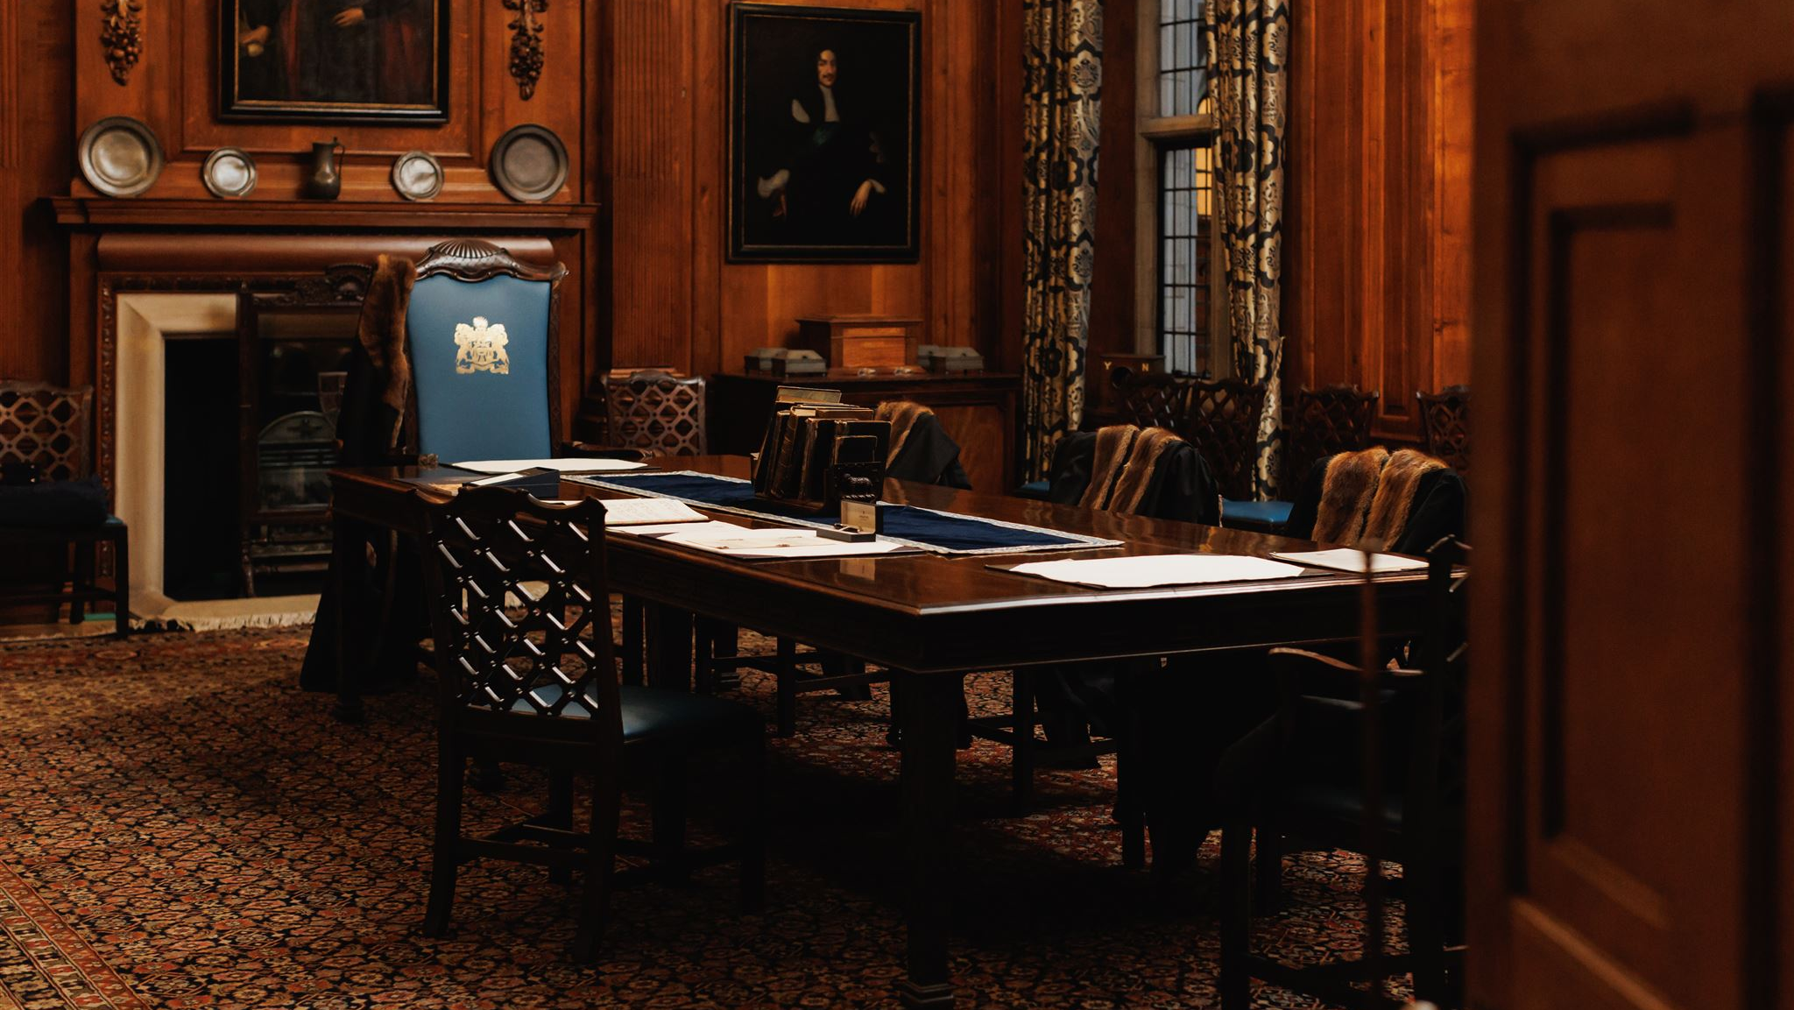
FORFEITURE

Slide 43
PITFALLS

Slide 44
Has the landlord waived the breach?
Has the forfeiture clause in the lease been triggered?
Can be waived even if can’t yet be exercised e.g. because no determination yet or no service of a s.146 notice
Does the landlord have knowledge of the breach?
Has the landlord acted in a manner so ‘unequivocal it can only be regarded as consistent with the lease continuing’?
Communicated to the tenant/had some impact on them; intention to waiver is irrelevant; acceptance of rent; relying upon covenants of the tenancy;

Slide 45
Practicalities & Procedure

Slide 46
STEP 1:
CHECK THRESHOLD MET
Must be:
>£350 outstanding
or
sums unpaid for >3 years
s.167 Commonhold and Leasehold Reform Act 2002 (“CLARA 2002”)
Rights of Re-entry and Forfeiture (Prescribed Sum and Period) Regulations 2004
Notes:
For ground rent; service charges and/or administration charges

Slide 47
STEP 2:
CHECK LEASE
Must have:
Express right to forfeit or right to re-enter
+ No waiver

Slide 48
STEP 3:
Admission or Determination
Breach must be:
Admitted by leaseholder or determined by County Court/FTT
s.168 CLARA 2002 and s.81 of the Housing Act 1996

Slide 49
STEP 4:
s.146 Notice
(14 days after admission/determination)
Must:
serve s.146 Notice at least 14 days after admission or determination
s.146 of the Law of Property Act 1925 and s.81 Housing Act 1996
Freeholders of 69 Marina, St Leonards on Sea v Oram [2011] EWCA Civ 1258

Slide 50
STEP 5:
ISSUE POSSESSION CLAIM
Must then:
Issue claim for possession (CPR 55)
Use bespoke Particulars of Claim, instead of N119 Form
N27 Form - Automatic relief from forfeiture 28 days
Notes:
Court serving property
A statement that the lease has been forfeited by the issue of the claim;
Particulars of the lease, with a full copy of the lease exhibited;
Particulars of the determination or admission + exhibiting admission/judgment
Particulars of the s146 notice (unless just ground rent) + exhibit copy of the notice
Particulars of any person (including a mortgagee) entitled to claim relief
Claim for legal costs particularising contractual costs clause

Slide 51
Summary
STEP 1: Check Threshold Met (>£350 or >3 years)
STEP 2: Check Lease (right to forfeit) + No Waiver
STEP 3: Breach admitted or determined
STEP 4: Serve s.146 Notice (14 days later)
STEP 5: Issue Possession Claim (CPR 55)

Slide 52
Thank you for joining
Laura Webster
laura.webster@newsquarechambers.co.uk
Rabby Fozlay
rabby.fozlay@newsquarechambers.co.uk

