Slide 1
A lawyer’s toolkit for dealing with vexatious litigants
DATE: Wednesday 7th May 2025
TIME: 11:00 - 12:00
LOCATION: Zoom

Slide 2
(A) WHAT ARE VEXATIOUS LITIGANTS?
CPR itself does not define “vexatious litigants”
When we characterise someone or something as ‘vexatious’, what we are doing is describing key behaviours. In other words, there is a tendency to focus on the symptoms, such as:
wholly disproportionate;
use of the legal system for a primarily non-legal purpose; and
harassment.

Slide 3
(B) MOTIVATION
Psychological and Emotional Drivers:
Perceived Injustice: A deep-seated belief they have been wronged, even if unfounded, fuels a desire for retribution or validation.
Obsession/Fixation: An inability to move past a grievance, often escalating into compulsive litigation.
Personality Disorders: Traits like narcissism or paranoia may lead to delusions of persecution or an inflated sense of entitlement.
Control and Power: Litigation become a tool to dominate others, especially if they feel powerless in other aspects of life.

Slide 4
(B) MOTIVATION
Strategic or Manipulative Goals
Harassment: Intending to burden opponents with legal costs, stress, or reputational damage.
Financial Gain: Hoping for out-of-court settlements, even with weak cases, exploiting the adversary's desire to avoid hassle.
Attention-Seeking: Craving recognition or validation through courtroom drama or public sympathy.
Protest or Principle: Using claims to challenge systems or policies, prioritising symbolic resistance over legal success

Slide 5
(C) SYMPTOMATIC APPROACH
A symptomatic approach stresses the management of vexatious litigants—focusing on curbing their disruptive behaviours without focusing on the underlying motivations:
Civil Restraint Orders.
Civil Proceedings Order.
Injunctions.
Third Party Costs Orders.
Procedural challenges such as strike out. etc.

Slide 6
(D) CIVIL RESTRAINT ORDER
This is a self-contained procedure which is governed by CPR r.3.11, supplemented by CPR PD 3C.
The concept of "totally without merit" orders is pivotal in the framework of civil restraint orders in the UK.
In practice, following the dismissal of a vexatious claim or application or appeal, consider inviting the Judge to certify that it was totally without merit.

Slide 7
(D) CIVIL RESTRAINT ORDER (Cont..)
Limited Civil Restraint Order (LCRO): It can be made when a party has made two or more applications in the same proceedings that are totally without merit. This order restrains the party from making further applications in those proceedings without court permission.
Extended Civil Restraint Order (ECRO): It can be issued when a party has persistently made claims or applications that are totally without merit across multiple proceedings. In practice, 3 or more TWMs. This order restrains the party from making applications related to the same matter without court permission.
General Civil Restraint Order (GCRO): It is appropriate when an extended civil restraint order is insufficient, covering all claims and applications in identified courts. Again, at least 3 or more TWMs. This order is for parties who persist in issuing totally without merit claims or applications in varying contexts.

Slide 8
(D) CIVIL RESTRAINT ORDERS (Cont..)
The difference between LCRO and the other two is the need to show persistence.
The court has a discretion as to whether to make a CRO and the type.
A Judge of any level may make a LCRO. The other two may be made by a Court of Appeal judge, a High Court judge, or a designated civil judge (or their appointed deputy in the County Court).
Upon dismissal as TWM, a court is required to consider whether it is appropriate to make a Civil Restraint Order (CRO).
"Party" has been held to be wide enough to cover a non-party who is considered to be the "real party" to the proceedings. See Churchill Ltd v Open College Network SouthEastern Region Ltd (t/a Laser Learning Awards) [2018] EWHC 1691 (QB)), and to McKenzie friends (Re Baggaley [2015] 1496 EWHC (Fam)).
While the jurisdiction under CPR r.3.11 does not apply to tribunals, the High Court can assist inferior courts by making a general civil restraint order under its inherent jurisdiction. See Law Society v Otobo [2011] EWHC 2264 (Ch) and Nursing and Midwifery Council v Harrold [2015] EWHC 2254 (QB).

Slide 9
(E) OTHER OPTIONS
Civil Proceedings Order
To obtain a CPO, an application must be made by the Attorney General to the High Court.
The statutory preconditions under section 42 of the Senior Courts Act 1981 must be satisfied i.e. habitually and persistently instituted vexatious civil proceedings without reasonable grounds from continuing to do so.
Injunction under the Protection from Harassment Act 1997
Perhaps to prevent vexatious correspondence with various public authorities amounting to unacceptable intrusions into privacy and personal affairs see Hayes v Willoughby (2013) UKSC 17

Slide 10
(F) SYMPTOMATIC APPROACH: PROBLEMS
Potential problems:
Ignoring psychological or systemic causes can inadvertently escalate and ignite the litigation into a psychological battleground.
Litigators follow a cost-benefit framework which is predictable because rational parties acting in ways aligned with legal or financial self-interest.
Vexatious litigants operate outside this framework. Their actions are driven by psychological needs rather than legal merit or financial logic.

Slide 11
(G) MOVING BEYOND A SYMPTOMATIC APPROACH
Early Identification: If you suspect, check the list of general civil restraint orders maintained by HMCTS.
Document: Compile publicly available documents to establish a fact pattern.
Limit engagement: Set clear, firm boundaries. Refuse to engage in non-legal debates or personal attacks. Do not fuel obsessions.
Record everything: Create a clear record of abusive behaviour to support sanctions.
Manage client’s expectations: Explain that the litigant’s goal may not be legal victory but harassment and advise against retaliatory actions.

Slide 12
(G) MOVING BEYOND A SYMPTOMATIC APPROACH (Cont..)
Gestures: For institutional clients (e.g., businesses), suggest policies to de-escalate (e.g., offering a symbolic apology or dialogue to address perceived grievances).
Resolve: Give the litigant a platform to “be heard,” potentially satisfying their need for validation.
Avoid Emotional Burnout: Rotate team members handling high-conflict case. Ensure responses remain professional; avoid retaliatory tactics that could escalate conflict.
Aggressive Procedural Enforcement: Move to dismiss frivolous claims quickly. Request sanctions or litigation restraints (e.g., requiring court approval for future claims.

Slide 14
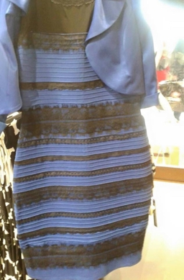
Mediating with vexatious litigants
When enough cognitive biases merge, anyone can become a vexatious litigant
Naive realism
Confirmation bias
Introspection illusion

Slide 15
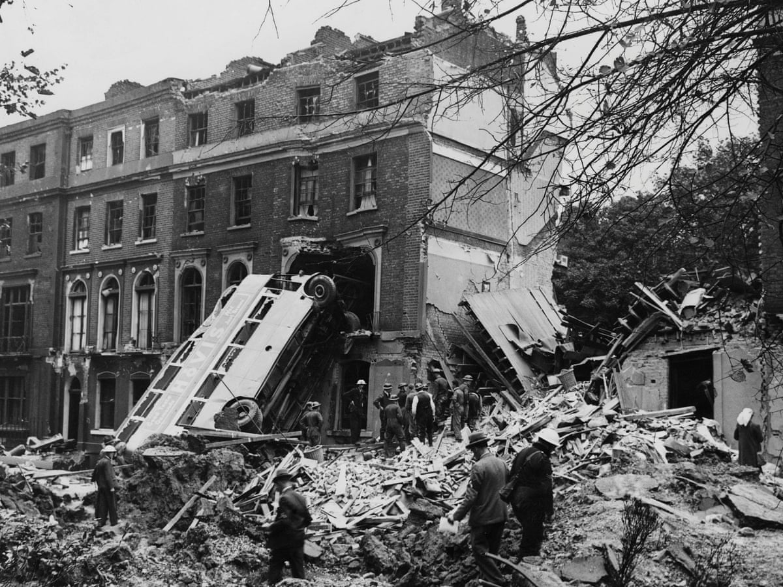
Avoiding trench warfare
Avoid positional negotiation
Understanding the conspiracy theorist mindset
Empathy v sympathy

Slide 16
Dynamic mediation
Act early
Fragment the process
Consider separate negotiations teams
Don’t approach it like a trial
Attack the problem not the people
Try and identify the driver

Slide 18
Harm to reputation
Not ‘what’, but ‘why

Slide 19
Commencement of litigation
The harsh truths
Can’t physically prevent litigation*
A parties’ ‘privilege’ to say what they want
Court rules don’t provide an effective solution
Court file is opened to the public
*unless CRO or injunction

Slide 20
During litigation
Risk of reporting on the proceedings and privilege
Privilege a sword and a shield
Control publication
Privilege can sit at the heart of a Defendant’s strategic approach
Defendant can start to shape the narrative around the litigation

Slide 21
During litigation (cont…)
Strike out of all or part of statement of case (claim doesn’t end)
Three grounds for strike out (CPR r.3.4)
Ancillary benefits
Summary Judgment (claim ends)
No real prospect of success and no other compelling reason
If not successful, might narrow the issues

Slide 22
Conclusion of litigation
Publicise judgment and rely on privilege (again!)
Online audit and clean up
No legal obligation to update reporting, but at least arguable
One possible exception for individuals
Reflect and consider next steps

Slide 23
Any Questions?

Slide 24
Thank you for joining
Jeff Hardman Jeff.Hardman@NewSquareChambers.co.uk
James Hazel James@in-houselimited.com
Steven Hudson Steven.Hidson@schillingspartners.com

