Slide 1
Insolvency Bites
DATE: Tuesday 18th March 2025
TIME: 15:00
LOCATION: Arundel House, Six Temple Place, London WC2R 2PG

Slide 2
Welcome & Introduction

Slide 3
AMUSE BOUCHE
Thank you

Slide 4
Debt, Policy and Breathing Space…

Slide 5
About StepChange Debt Charity
Specialist debt advice charity
Policy advocate
Work across the UK
Provider advice and debt solutions, including breathing space
In 2024 170,000 completed full debt advice

Slide 6
Household debt now
Cost of living pressures yo-yo… but still high
Coping strategies and future problems
Nature of debts
Nature of people seeking debt advice
Deficit budgets, outcomes and public policy…

Slide 7
Aims of our policy work
Reduce debt vulnerability
Reduce the harm debt causes
Increase financial resilience / long term financial health

Slide 8
Some current policy issues
Energy debt and different approaches to debt relief
Financial Inclusion Strategy
Child Poverty Task force
Government / local government debt
Debt enforcement
Insolvency

Slide 9
Insolvency and debt solutions
Debt solutions market, Regulation, CONC 8 etc.
IS insolvency review:
Box of stuff…

Slide 10
Breathing space
Client outcomes
Policy issues

Slide 11
STARTER (FOR 10)
Thank you

Slide 12
The Top 10 Insolvency Cases of the 2020s

Slide 13
10
Umbrella Care Ltd (In Liquidation) v Raja
[2024] EWHC 1973 (Ch)
S.363 IA 1986 confers jurisdiction on the court to direct a bankrupt not to leave the country and to hand over their passport if there is a real risk of them absconding, such that some part of the insolvency process would be materially prejudiced.
Key takeaway: demonstrates the breadth and extent of the court’s power to assist trustees in administering the bankruptcy estate.

Slide 14
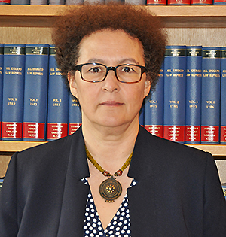
9
Re Systems Building Services Group Ltd
[2020] EWHC 54 (Ch)
Directors’ general duties survive the company’s entry into administration or CVL.
Key takeaway: simply continuing to be a director is sufficient for director’s duties to be engaged; it is not dependent upon the exercise of a given power qua director.

Slide 15
8
Brake v The Chedington Court Estate Ltd
[2023] UKSC 29
Bankrupts do not generally have standing to challenge trustees’ decisions under s.303 IA 1986 unless they meet specific criteria.
Key takeaway: provides reassurance to office holders that bankrupts cannot easily intervene in their decisions; specific categories of persons/circumstances required.

Slide 16
7
Manolete Partners plc v Hayward and Barrett Holdings Ltd
[2021] 1481 (Ch)
In hybrid claims, a single claimant may be required to commence two sets of proceedings (insolvency application + CPR Pt 7 claim) even though they arise out of the same facts and seek similar/overlapping relief.
Key takeaway: £££
with regret…

Slide 17
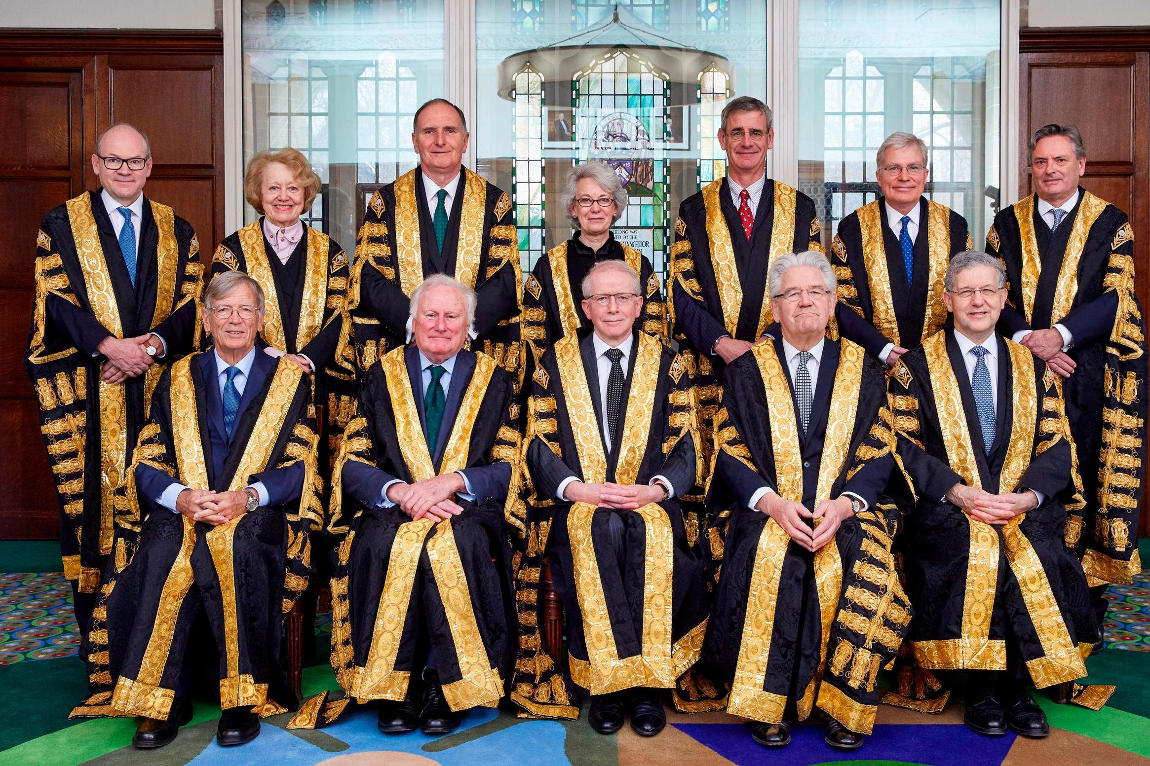
6
Kireeva v Bedzhamov [2024] UKSC 39
A foreign bankruptcy trustee has no claim to the bankrupt’s immovable property in England and Wales.
Key takeaway: creditors must carefully consider in which jurisdiction they apply for a bankruptcy order.

Slide 18
5
Sian Participation Corp (in liquidation) v Halimeda International Ltd [2024] UKPC 16
A debt must be the subject of a genuine dispute on substantial grounds for the court to stay or dismiss a creditor’s winding up petition in favour of arbitration.
Key takeaway: despite this decision arising out of BVI litigation, it has direct implications for English law; the Privy Council overturned Salford Estates, which had introduced a more pro-arbitration stance.

Slide 19
4
Servis-Terminal LLC v Drelle [2025] EWCA Civ 62
A bankruptcy petition cannot be presented in respect of a foreign judgment which has not been the subject of recognition proceedings.
Key takeaway:
additional time & costs
involved for creditors in
obtaining recognition.
creditor
CoA
unrecognised
judgment

Slide 20
3
Mitchell v Al Jaber [2024] EWCA Civ 423
A director remained subject to a continuing fiduciary duty post liquidation when purporting to transfer assets owned by the company. It arose not by virtue of his continuing office as a director, but on the basis that he was an “intermeddler”.
Stay tuned…further appeal to be heard by UKSC in May!

Slide 21
2
Invest Bank PSC v El-Husseini [2023] EWCA Civ 555/
[2025] UKSC 4
A “transaction” within the meaning of s.423 IA 1986 is not confined to dealing with an asset owned by the debtor, but by a company owned or controlled by him.
Key takeaway: the broad interpretation to the provision taken by the CA and now endorsed by the SC may lead to greater recourse by IPs to this provision.

Slide 22
1
BTI 2014 LLC v Sequana SA [2022] UKSC 25
There is a duty to have regard to the interests of creditors, and that duty is preserved by s.172(3) CA 2006.
The duty is a part of the directors’ fiduciary duties to act in good faith for the benefit of the company. It is not a freestanding duty owed to creditors but, when triggered, the “interests of the company” expand to include the interests of the company’s creditors as a body.
This “creditor duty” is triggered when the company is insolvent or bordering on insolvency.

Slide 23
FISH(ING)
Thank you

Slide 24
Information Gathering and Investigations

Slide 25
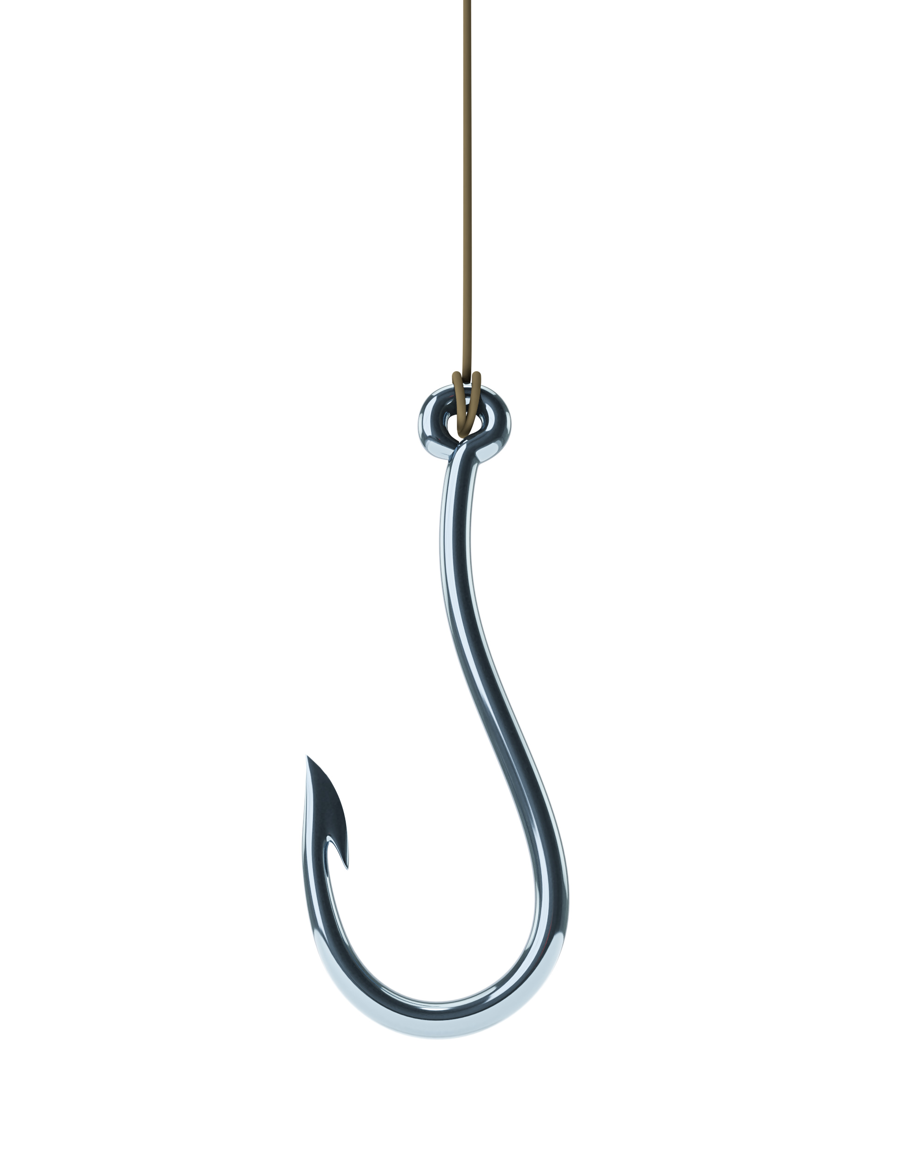
Overview
Information gathering from third parties
Provision of information to third parties

Slide 26
Information gathering from third parties
Group companies
Re Eversholt Rail (365) Limited (In Liquidation) [2024] EWHC 2217 (Ch)
Professional advisors (accountants, auditors, solicitors)
Re Eversholt Rail (365) Limited
Re NMCN PLC (In Liquidation) [2025] EWHC 446 (Ch)

Slide 27
Provision of information to third parties
Assignees:
Asertis Limited v Melhuish [2024] EWHC 2819 (Ch)
Confidentiality and privilege issues:
Re Eversholt Rail (365) Limited
Asertis Limited v Melhuish
Re Farfetch Limited (In Liquidation) [2024] EWHC 3340 (Ch)

Slide 28
Break

Slide 29
MEAT (OR IS IT?)
TRUSTS IN INSOLVENCY
Thank you

Slide 30
Trusts in Insolvency

Slide 31
Pyramid Homes Co Ltd
Estate Agents
Commission and fees
Deposit custodian
Receipt of funds for renovation projects

Slide 32
Are they trust funds?
What to look for?
Segregation (Re Lehman Brothers [2010] EWCA Civ 917)
Freedom to mix and freedom to use (debtor, agent, trustee?)
Exclusive purpose (Prickly Bay Waterside Ltd v British American Insurance Company Ltd [2022] UKPC 8)
Uncertain pools
“It is enough if the beneficiaries can be ascertained with the requisite certainty at the creation of the trust, and it will not later be invalidated because some of the class might have disappeared or become impossible to find or because it has been forgotten who they were”
RE Allanfield Property Insurance Services Ltd [2015] EWHC 3721 (Ch) at [62(5)]

Slide 33
Why does it matter?
Not company assets and not company creditors(?)
Continuing trusteeship
Distributions and winding up
“The problems of identification arise only from the subsequent failure of the companies to keep proper records. That failure does not entitle the companies to appropriate to themselves moneys that they held on trust for their clients” (Allanfield Property Insurance Services Limited [2015] EWHC 3721 (Ch) at [62]).
Fees and Remuneration
Patel v Barlow Solicitors [2021] 4 WLR 6 at [288]: “An office holder will not usually be entitled to recover the costs, expenses and remuneration from the free assets of an insolvent estate for work done exclusively in relation to trust assets in which the general creditors of the insolvent estate have no interest…In such a case, he should usually seek to recover those costs, expenses and remuneration from the trust assets either under an express or implied provision of the trust or under some other legal basis, such as under the jurisdiction in Berkeley Applegate.”

Slide 34
What can/should be done?
Nothing?
Change of trusteeship
Distribution
Distribution plans
Notes:
Use Case – uncertain entitlements and fund deficiencies, unidentified beneficiaries
Absence of defined payment waterfall
The two jurisdictions: S.112 IA/Para 63 Sch B1 & CPR Part 64
Recent Examples:
ReTorotrak Plc (In Liquidation) [2023] EWHC 115 (Ch) (CVL surplus)
Re Hyde [2021] EWHC 1542 (Ch)
Supercapital Ltd (In Administration) [2020] EWHC 1685 (Ch)
Pritchard Stockbrokers Ltd (In Special Administration) [2019] EWHC 137 (Ch)
Hunt v The FCA [2019] EWHC 2018 (Ch) (see Annex A in particular for terms of order)

Slide 35
What role for the IP?
HEC Enterprises [2016] EWHC 3179 (Ch)
If the company holds property on trust for others, an administrator does not become a trustee of that property. The company remains the trustee.
Accordingly, an administrator does not owe the duties of a trustee to the beneficiaries under the trust.
However, an administrator's functions and powers extend to doing anything necessary or expedient for the management of the affairs of the company. This gives an administrator power to do what is necessary or expedient in certain respects in connection with property held by the company as trustee.
Re Pritchard Stockbrokers [2019] EWHC 132 (Ch) at [25]:
“…how the company should discharge its duties as trustee and execute the trusts upon which it holds property, and how it should avoid the generation of claims for breach of trust which would lie against its assets, are key questions to be addressed by the administrator: and he or she can properly seek directions as to how to perform their function in that regard.”
Notes:
Can owe “duties” or at the very least have a role to play via the backdoor – avoiding exposing the corporate trustee to liabilities for breach of trust which are claims against the company
(a) Post-liquidation debts
12-012 (McPherson)
Debts and other liabilities incurred by the liquidator after the winding up cannot be proved, but must be paid in full as part of the expenses of winding up.⁹¹ Common examples are rent and rates in respect of premises occupied by the liquidator on behalf of the company,⁹² debts incurred in carrying on business, the costs involved in realising company property and the costs of legal proceedings conducted by the liquidator in getting in company property.

Slide 36
Money for nothing?
The Corporate Trustee Co
A trustee (acting properly) has right of indemnity from trust assets, Halabi v Equity Trust [2022] UKPC 36
An IP has no right to use trust assets to meet expenses of liquidation and may need the court’s assistance
Re Berkeley Applegate (1988) 4 B.C.C. 279
E.g. Re Hyde [2021] EWHC 1542 (Ch)
Can and should seek orders prospectively:
Re Telesure Ltd [1997] B.C.C. 580

Slide 37
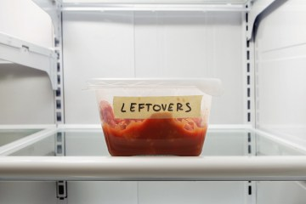
“monies held on trust should remain held on trust. The Court cannot transfer the trust funds beneficially owned by clients into funds of PASF to be distributed to its creditors.”
Re Phillip Alexander Securities And Futures Limited (2013, unrep.)
"

Slide 38
CHEESE
Thank you

Slide 39
Offshore Round-Up

Slide 40
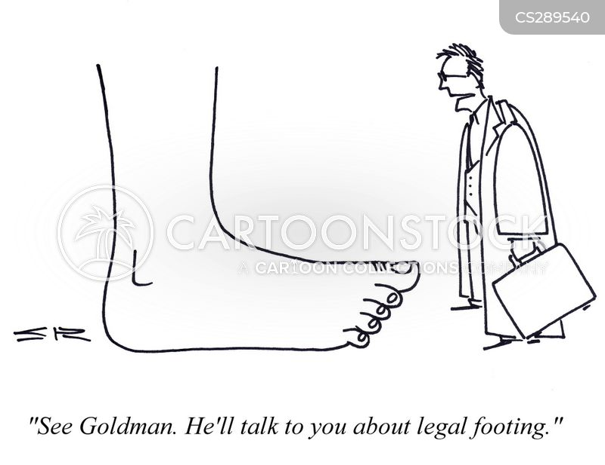

Slide 41
Floreat v XYZ (BVIHCMAP2023/0017)
Can a petitioner with a beneficial interest to shares bring a winding up petition?
Basis on which standing was asserted:
Holds signed instruments of transfer the shares from his nominee (and therefore was a ‘member’ in the extended sense as defined in section of the Insolvency Act).
He nevertheless had standing on a “derivative” basis.
Court of Appeal accepted the Petitioner had standing on a “derivative” basis.

Slide 42
Background
Section 273: “A person aggrieved by an act, omission or decision of an officeholder, may apply to the Court and the Court may confirm, reverse or modify the act, omission or decision of the officeholder.”
Re Edennote [1996] BCC 718
Re Edengate [2022] EWCA Civ 626
Section 210(2): “The Court, on the application of a liquidator or, where the liquidator declines to make an application under this subsection, a creditor, may expunge or amend an admitted claim if it is satisfied that the claim should not have been admitted or should be reduced.”

Slide 43
Stevanovich v Richardson and anr (Joint Liquidators of Barrington Capital Group) JCPC/2023/0104
Issues:
Can a former director of a company in liquidation, apply under section 273 to reverse a liquidator’s decision to admit a claim in liquidation?
Can the court exercise its inherent jurisdiction to compel a liquidator to make an application under section 210 to amend or expunge the claim?
Mr Stevanovich, unsuccessful at first instance and on appeal.
Heard by the Privy Council in December 2024; Awaiting judgment

Slide 44
DESSERT
Thank you

Slide 45
Litigation Funding and Costs –
A Fireside Chat

Slide 46
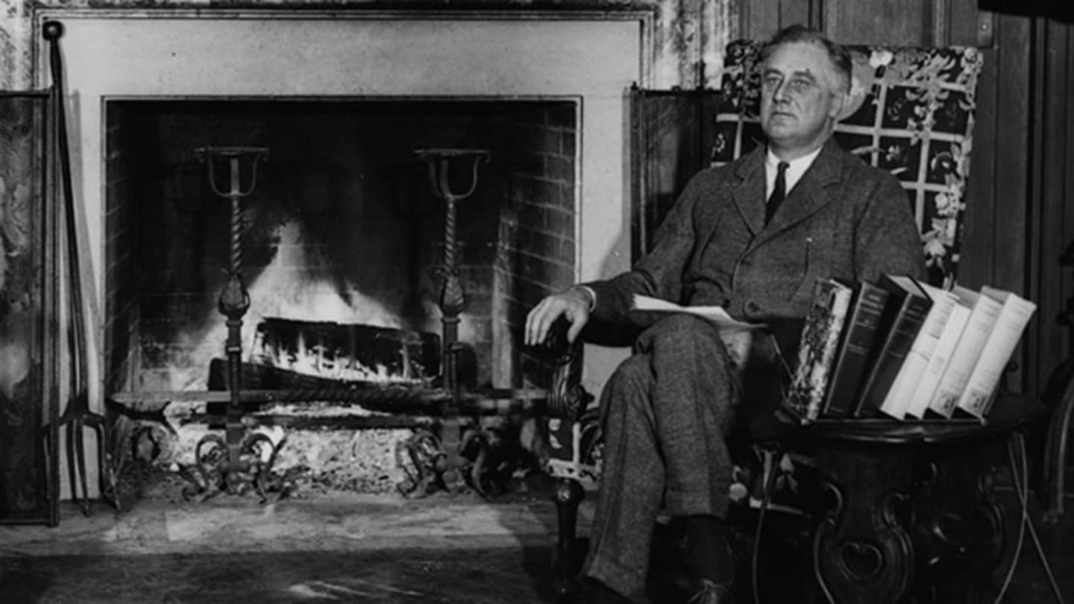

Slide 47
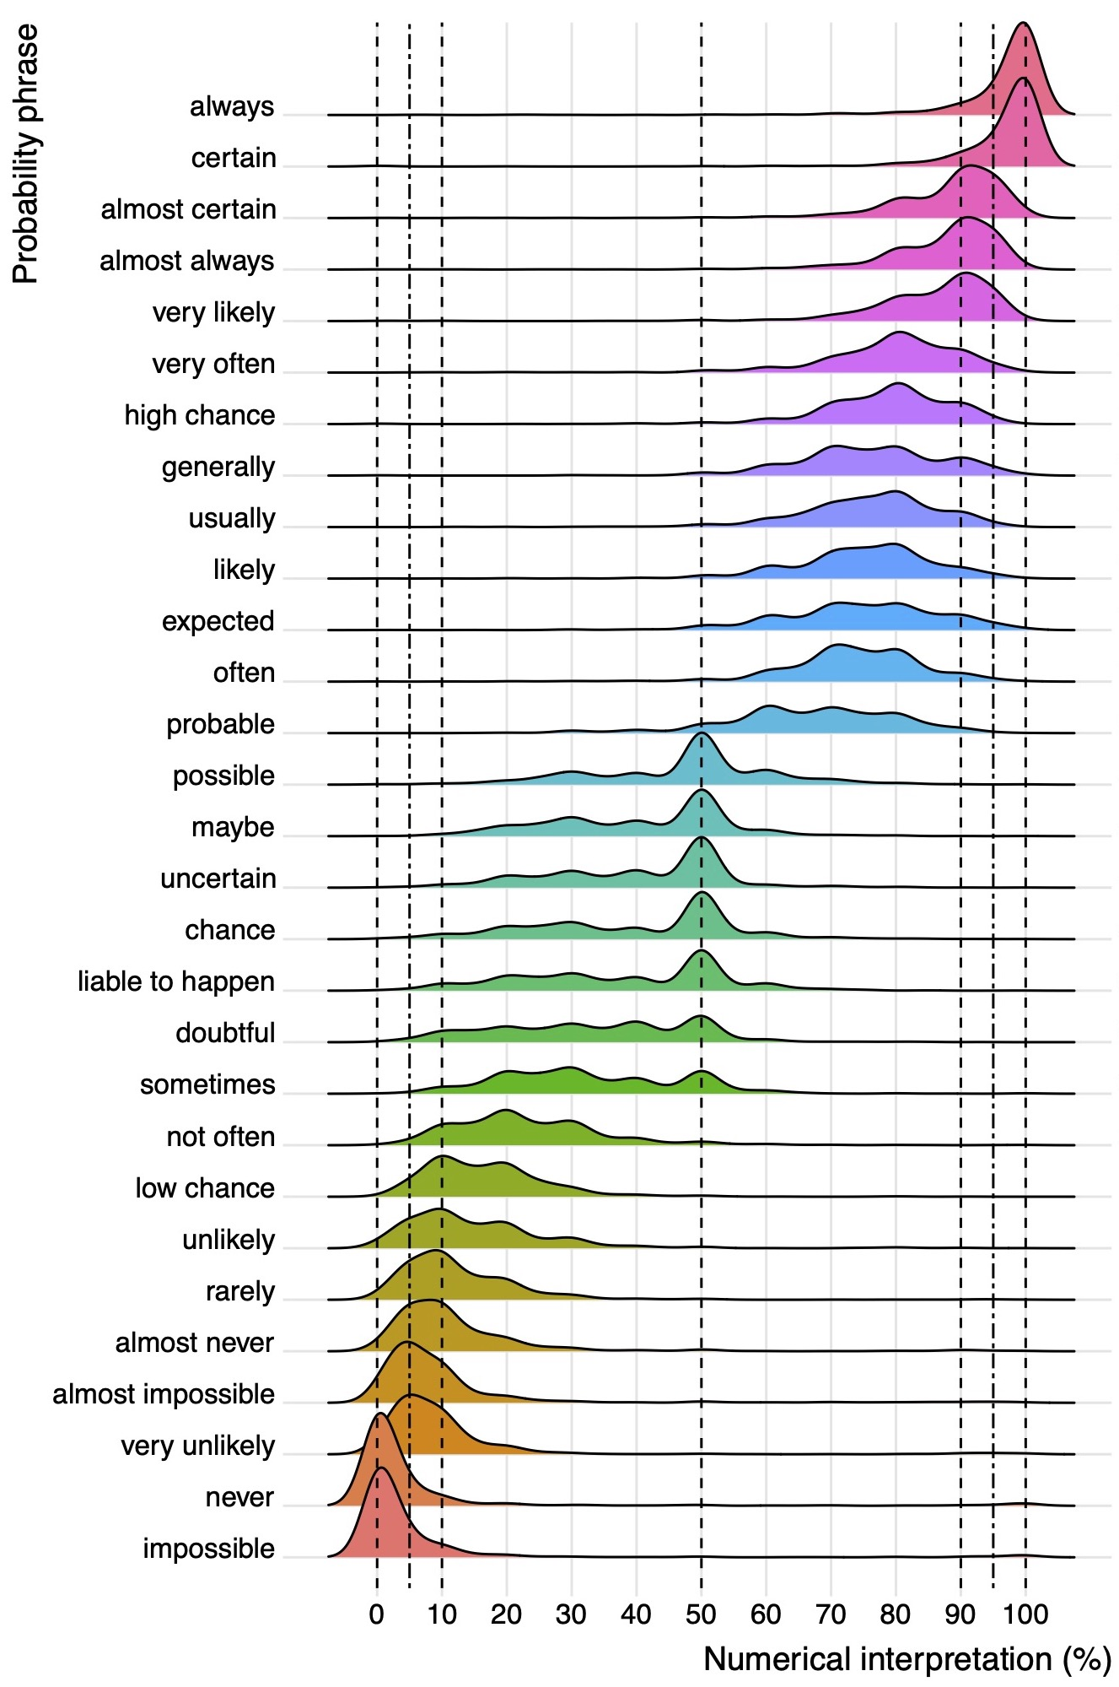
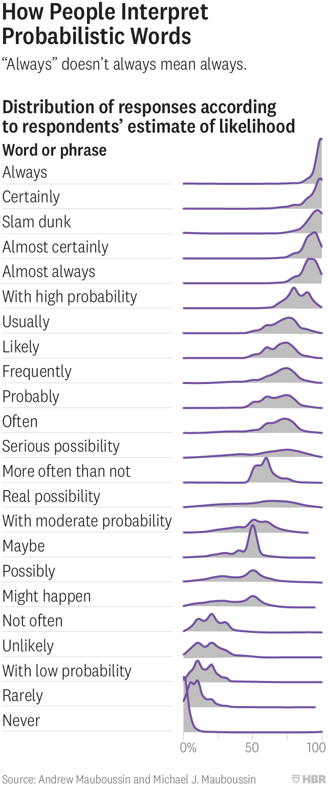

Slide 48
Closing Remarks

Slide 49
Thank you for joining us today
Refreshments, Canapes & Networking

