Slide 1
‘Sweet Child of Mine’
Conduct and claims under the Inheritance Act
TRUST, WILLS & ESTATES
DATE: Wednesday 26th March 2025
TIME: 11:00 – 12:00
LOCATION: Zoom

Slide 2
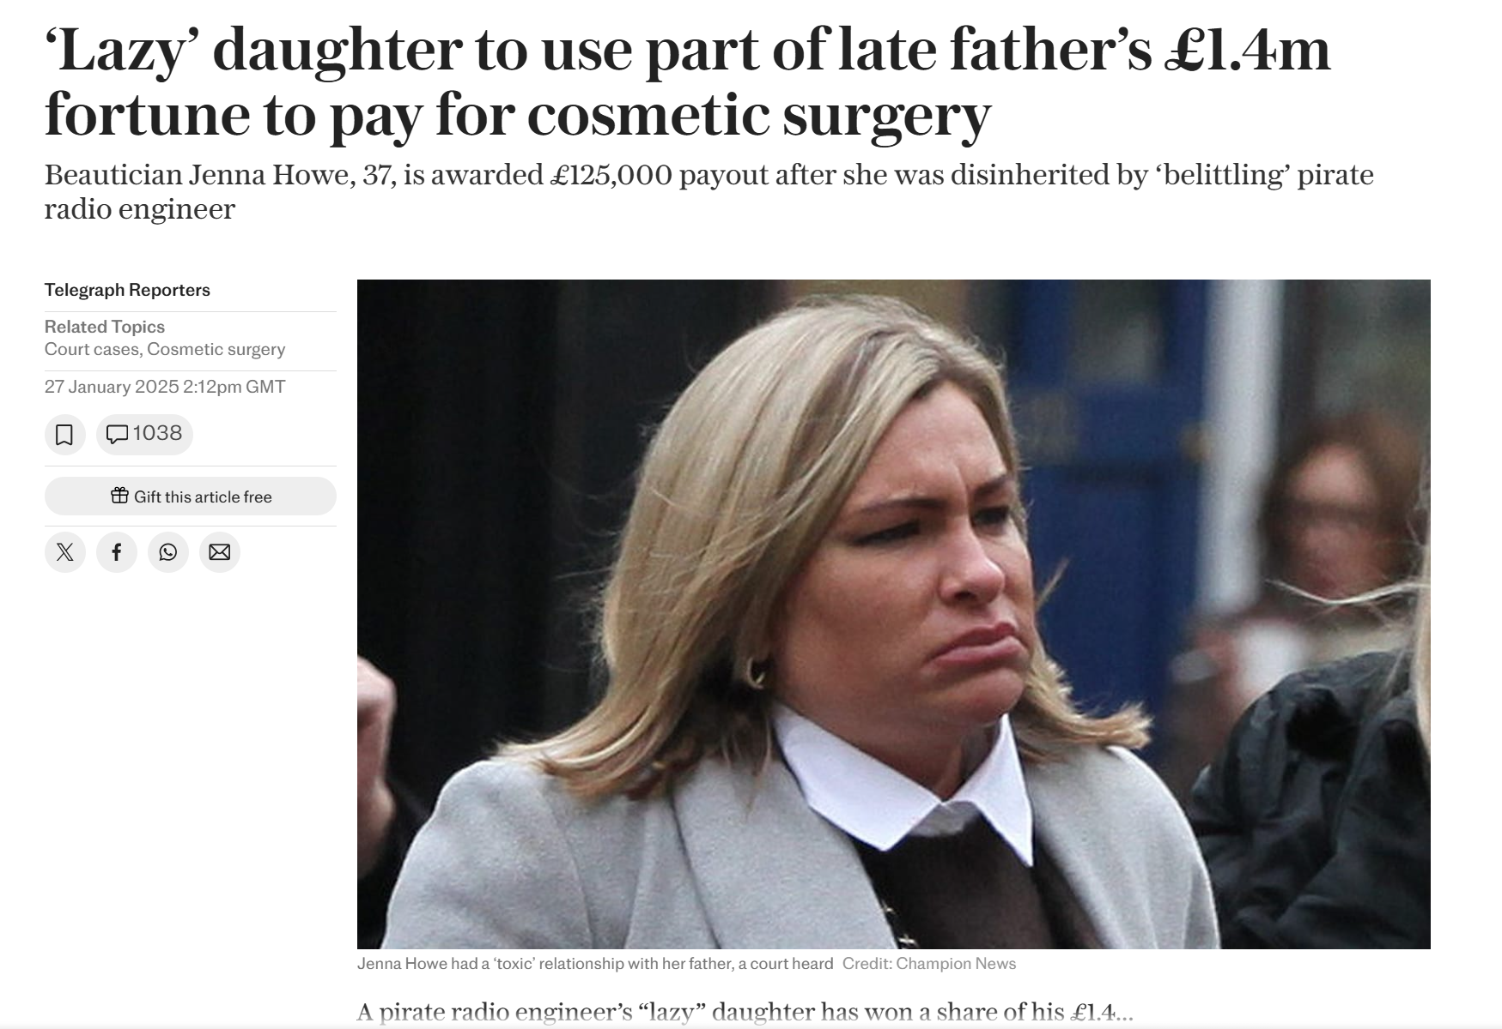

Slide 3
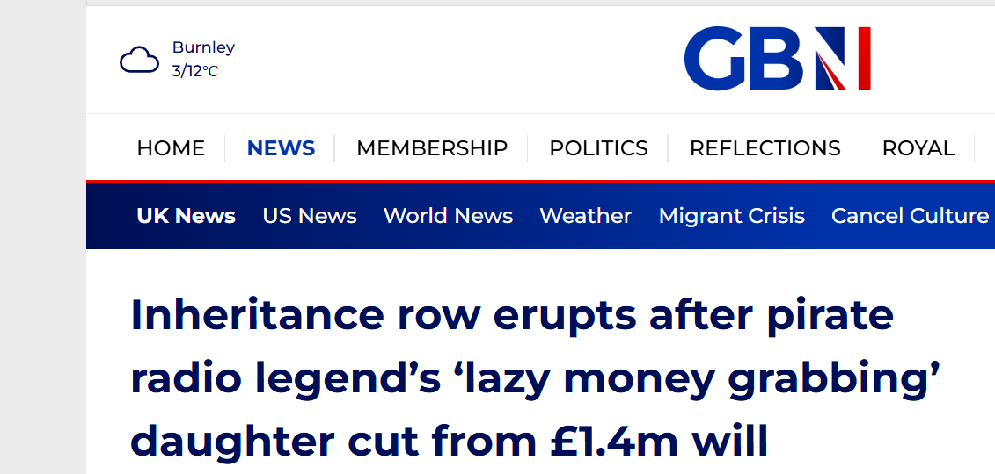
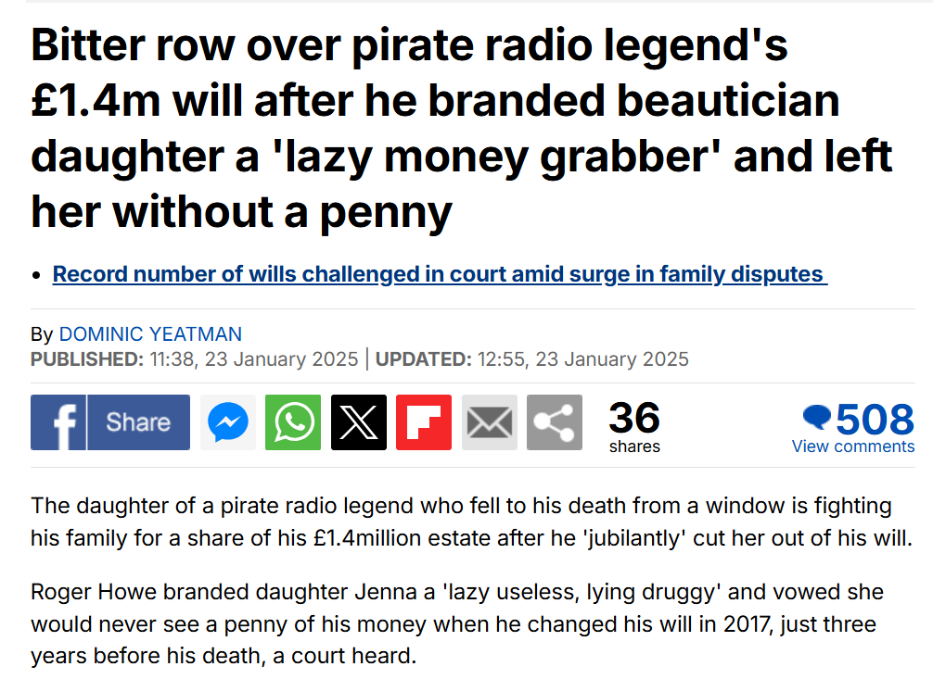

Slide 4
Conduct
Conduct: basics and origins
Howe and the ‘conduct fixation’
The killers
The percentage approach
Where good conduct can help a claim
Practical tips: alleging and defending (mis)conduct

Slide 5
Conduct: basics
‘3 Matters to which court is to have regard in exercising powers under s. 2.
(1)Where an application is made for an order under section 2 of this Act, the court shall […] have regard to the following matters, that is to say—
(g)any other matter, including the conduct of the applicant or any other person, which in the circumstances of the case the court may consider relevant.’

Slide 6
Inheritance (Family Provision) Act 1938
Section 1(6):
‘(6) The court shall, on any application made under this Act, have regard to any past, present or future capital or income from any source of the dependant of the testator to whom the application relates, to the conduct of that dependant in relation to the testator and otherwise, and to any other matter or thing which in the circumstances of the case the court may consider relevant or material in relation to that dependant, to the beneficiaries under the will, or otherwise.’

Slide 7
Inheritance (Family Provision) Act 1938
In Re Borthwick, Decd. [1949] Ch. 395 at 401:
‘When one looks at sub-s. 6 of s. 1, it is seen that one of the matters to which the court is directed to pay attention is the
"conduct of that dependant in relation to the testator and otherwise."
I cannot think that the conduct of the dependant towards the testator or otherwise can make the difference between whether you leave her starving in the gutter or no. The courts have not taken that view.’

Slide 8
Howe v Howe
Adult child claim
Defended principally on conduct grounds
Father left estate to family members without competing need
C convicted of harassing a defendant
Had previously brought failed probate claim (bankruptcy proceedings failed: Howe v Leck Holdings Limited [2024] EWHC 1842 (Ch))
HHJ Raeside KC awarded C £125,000
Part 36 beaten: indemnity costs

Slide 9
The ‘conduct fixation’
Of the section 3 factors, few attract as much emotion or attention as conduct
However, few examples of conduct factors making any difference
See eg Howe and:
Iqbal v Ahmed [2011] EWCA Civ 900 (‘conduct was largely irrelevant’ at 10);
SH v NH [2020] EWHC 1134 (Fam) (claimant caused ‘great grief’ to parents at 62(iii))
Rochford v Rochford [2021] W.T.L.R. 951
Chiemelu v Egemonye [2023] W.T.L.R. 23

Slide 10
Ilott v Mitson [2017] UKSC 17:
‘These matters of conduct were not irrelevant, but care must be taken to avoid making awards under the 1975 Act primarily rewards for good behaviour on the part of the claimant or penalties for bad on the part of the deceased’
Ilott at 47 per Lord Hughes

Slide 11
The classic conduct cases
Wright v Waters [2014] EWHC 3614 (Ch) per HHJ Behrens at 101: ‘When I take into account all the section 3 factors my value judgment is that Patricia Wright's conduct outweighs all of the factors in her favour […]’
Wellesley v Wellesley [2019] EWHC 11 (Ch) per Deputy Master Linwood at 198: ‘Taking into account all the s.3(1) factors my value judgment is that on the facts as known to me today Tara's conduct in terms of her responsibility for the extremely long estrangement for almost all of her adult life, with no reconciliation in prospect, outweighs all of the factors in her favour […]’
Lettice v Lettice [2022] EWHC 3013 (Ch) at 117.

Slide 12
Why do judges struggle with conduct?
Reluctance to make moral or behavioural judgments
Judicial background and experience
Evidential difficulties
Burden of proof - Re H (minors) (Sexual abuse: Standard of proof) [1996] AC 563
The last factor in section 3 (see eg Howe)
Above all – overreliance on conduct misunderstands the purpose of the Act (see Ilott)

Slide 13
The killers
Land v Land [2006] EWHC 2997 (Ch)
Meeking v Meeking [2013] All ER (D) 250 (May)

Slide 14
Land v Land [2006] EWHC 2997 (Ch)
C was the Deceased’s son and only beneficiary by will (‘the Will’)
C was convicted of manslaughter of the Deceased
Sentenced to four years’ imprisonment
C’s interest in the Will was forfeit
However, C’s Inheritance Act claim succeeded
‘The claimant must be and has been punished for the wrong that he did; he has also been punished by being deprived of the provision which the Deceased intended for him. But he should not be further punished by being deprived of the reasonable provision that he might otherwise expect under the 1975 Act.’ (HHJ Alastair Norris QC at 27)

Slide 15
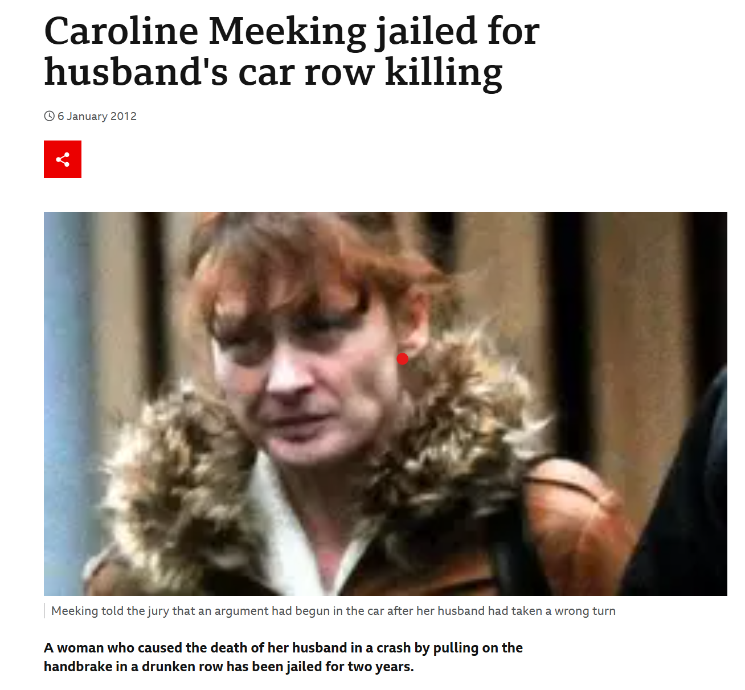
Meeking v Meeking [2013] All ER (D) 250 (May)
C convicted of manslaughter, sentenced to 2 years’ imprisonment
The Deceased died intestate
Relief from forfeiture granted
In the alternative, 1975 Act claim succeeded

Slide 16
The percentage approach
Jassal v Shah [2021] EWHC 3552 (Ch)
‘There is no way of dressing up this conduct. It was dishonest and knowingly dishonest. It was also part of a pattern of dishonest conduct relating to claims to benefits and the non-payment of taxes’ (Deputy Master Marsh at 13).
20% discount on award

Slide 17
What about good conduct?
Paul v Paul [2022] EWHC 1638 (Fam) at 30(b): ‘it is not the purpose of the 1975 Act to correct unfairness or provide rewards for good conduct.’
That said, specific regard to care in section 3(2)(b)
There are relatively few examples of parties whose good conduct has assisted a claim, mainly those who have cared for the Deceased (see eg Delaforte v Flood [2021] WTLR 499)

Slide 18
Practical tips: alleging (mis)conduct
Is it worth it? Costs consequences
Liaise with counsel
Be realistic about what can be proved – have in mind the undue influence / fraud analogy
Rely heavily on documents
Timing – pre- or post-mediation
Be discerning as to how, or if, you make these points at mediation
A means rather than an end in itself
Don’t forget the percentage approach

Slide 19
Tips: defending conduct allegations
Rely heavily on authority – wrong in principle
Remember possible costs consequences
Can you use allegations as an excuse not to mediate? (PJSC Aeroflot v Leeds [2018] EWHC 1735 (Ch))
Can these allegation be struck out?
Don’t forget PRs and wider context
Use conduct to paint the other side in a bad light
However, judges are only human

Slide 20
Any questions?
James McKean
James.McKean@newsquarechambers.co.uk

