Slide 1

Access Roads to
New Developments when the
Land is a Registered Common
DATE: Tuesday 17th September 2024
TIME: 15:30 – 16:30
LOCATION: Zoom
DATE: Tuesday 17th September 2024
TIME: 15:30 – 16:30
LOCATION: Zoom

Slide 2
Today’s talk
Paul Wilmshurst, a barrister at New Square Chambers, discusses a frequently occurring problem for many developers where an access road to a new housing development crosses land that is registered as a common. Common land is a highly protected category of land, and its use or development falls outside of the planning system.
A recurring theme is that developers leave the resolution of the issue too late or fail to make the correct application because of a lack of understanding of this niche area, which some planning lawyers or consultants may come across less frequently.
Seeking consent under s.38 Commons Act 2006: is this the right application for you to make anyway?
De-registration and exchange applications under s.16 Commons Act 2006.
How can you give your application the best chance of success and avoid costly mistakes

Slide 3
Restrictions on works on common land
Restricted Works under the Commons Act 2006
Works subject to the restrictions of Part 3 of the 2006 Act are those:
Exemptions
Common Land Covered by Schemes of Management

Slide 4
Section 16 Commons Act 2006
Application to Deregister Land
When is Exchange Land Necessary?
Nature of Land Required for Exchange
Procedure for Application & Exchange

Slide 5
Section 38 Common Act 2006
Procedure for Application & Exchange
Criteria for consent under section 38
Effect of Consent
Procedure

Slide 6
Conclusion
Examples – what is the correct application in your case?

Slide 7
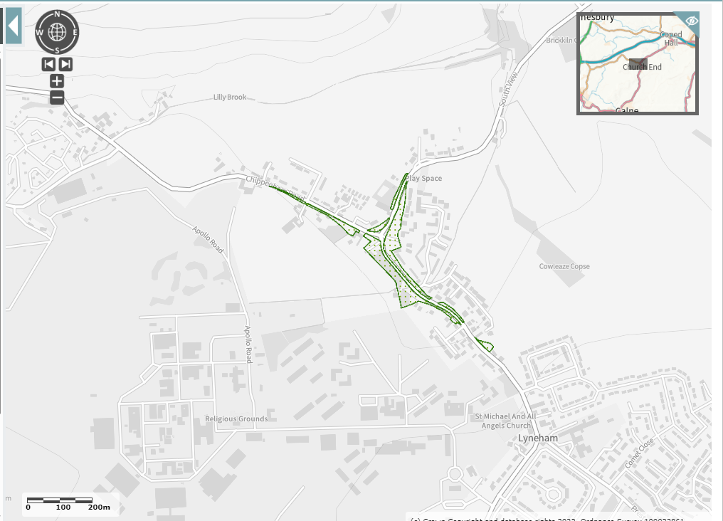
Lyneham Green Wiltshire (CL47)

Slide 8
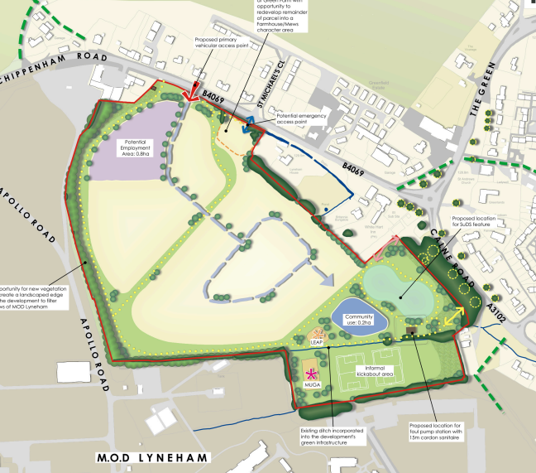

Slide 9
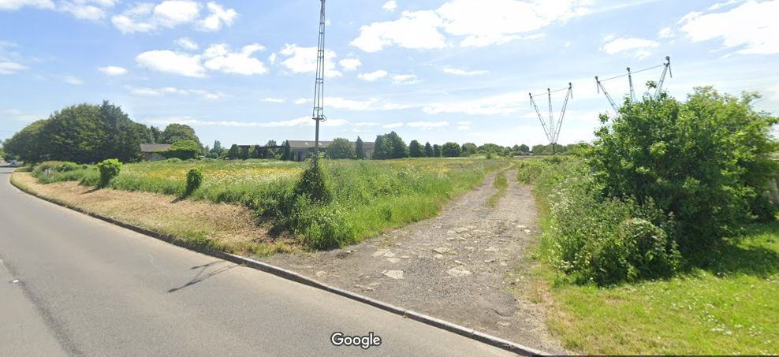

Slide 10
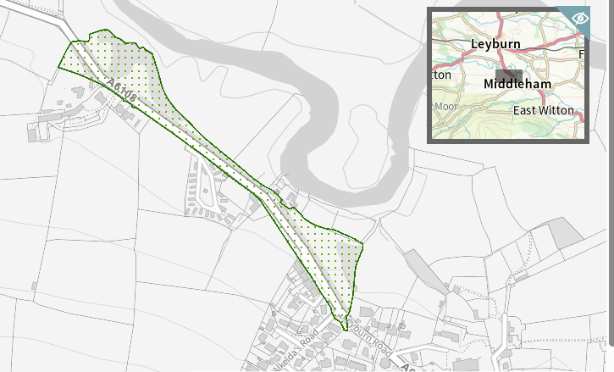
Middleham High Moor Richmondshire (CL52)

Slide 12
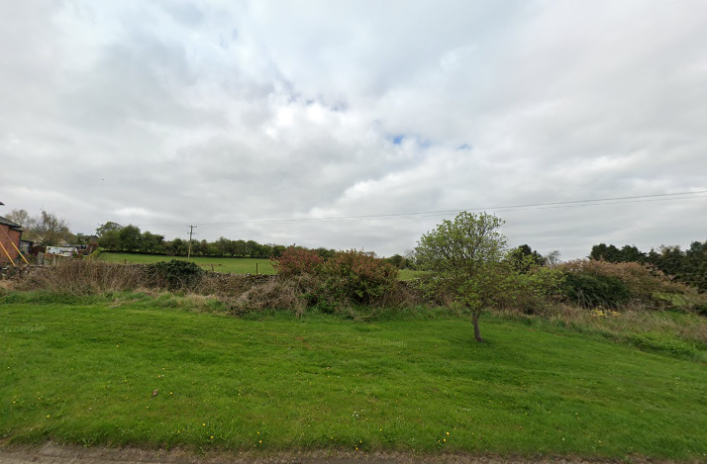

Slide 13
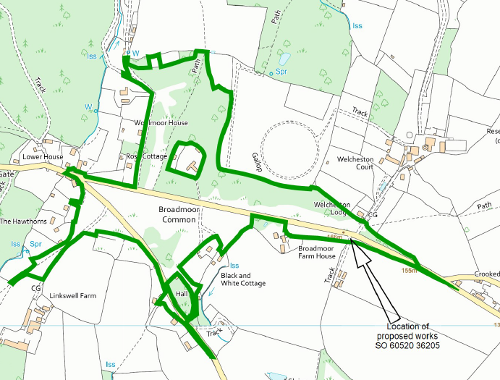
Broadmoor Common Herefordshire (CL85)

Slide 14
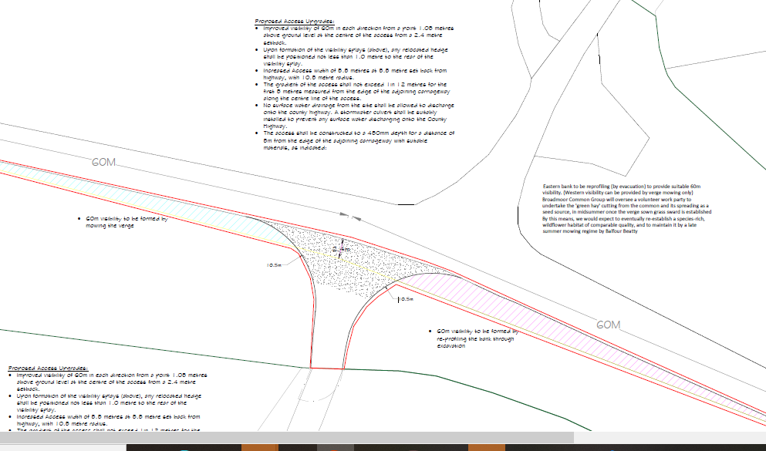

Slide 15
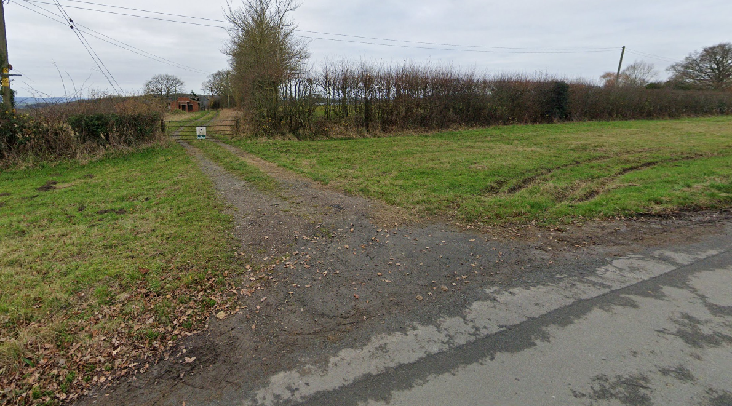

Slide 16

Thanks
for joining
Thanks
for joining
Paul Wilmshurst
Paul.Wilmshurst@NewSquareChambers.co.uk
Paul Wilmshurst
Paul.Wilmshurst@NewSquareChambers.co.uk

